Slide 1
Intersight Cloud Orchestrator
Deep Dive Deck
ICO TMEs
Cloud and Compute
Last Update: Apr 22 2022
Check the latest version of this deck here:
http://go2.cisco.com/ico-deep-dive-deck

Slide 2
About This Document
This document aims to provide a detailed insight of Intersight Cloud Orchestrator (ICO) capabilities through examples.
Note: some screenshots may change over time due to the nature of Intersight, please refer to the documentation on https://intersight.com/help
Internal users are encouraged to share feedbacks or notify errors/inconsistencies through the mailer ask-ico-tme

Slide 3
Table of Content
Sample Scenario
Custom Data Types
Task Designer - Web API Executor and Outcomes
Workflow Designer
Validate and Execute a Workflow
Use Task Inputs
Conditional Task
Parallel Loops
Workflow Variables
Serial Loops
Workflow Versioning
Transformations
Rollback Tasks
Create a Notification Task with Webex
Powershell Executor
SSH Executor
Ansible Executor
Go Templates Cheat Sheet (Advanced Mapping)
ICO Intersight API
Execute an ICO Workflow from Terraform
Execute an ICO Workflow with the Python SDK
Execute an ICO Workflow with Powershell SDK

Slide 4
Sample Scenario

Slide 5
Example workflow
Goal:
Fetch current weather in a given city
Return a structured workflow output
How:
Openweathermap.org
Build and map Custom Data Types (CDTs)
Use the Task Designer and the REST API executor and map CDTs
Create a workflow that uses the CDT as input and the custom task

Slide 6
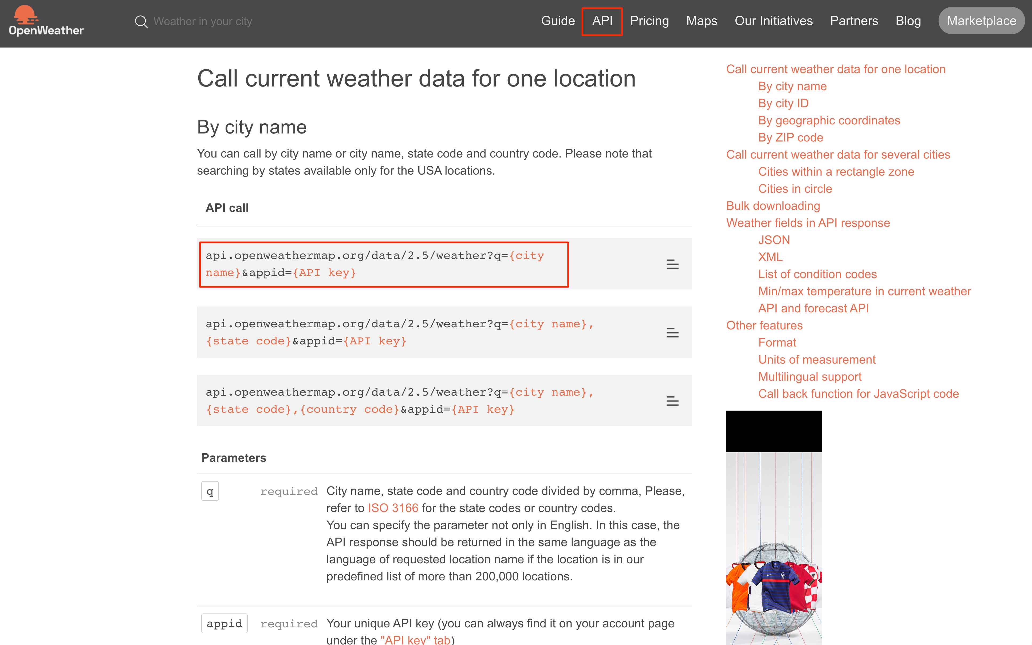
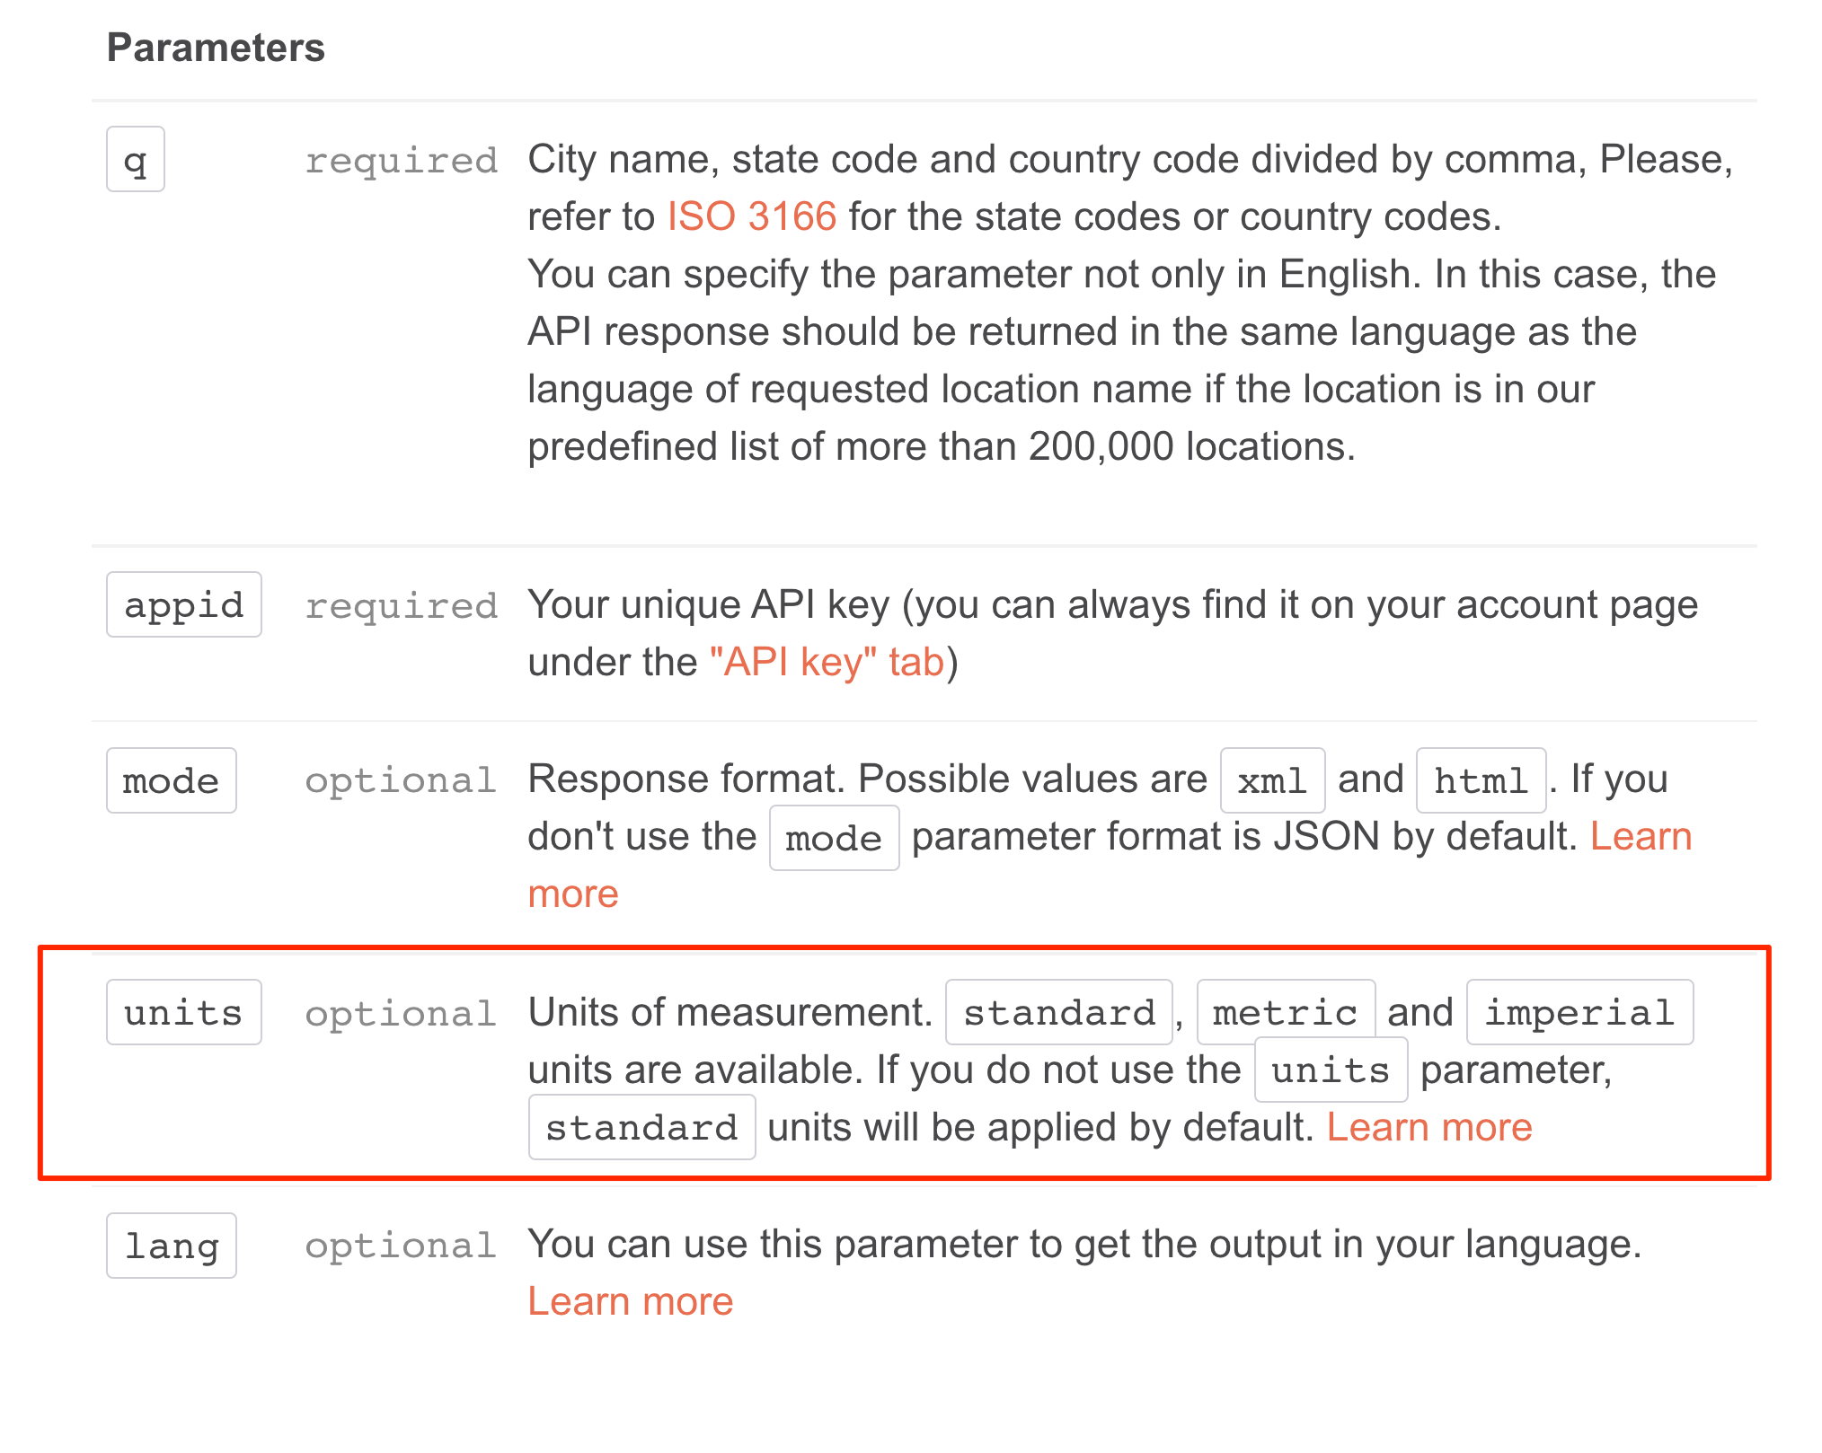

Slide 7
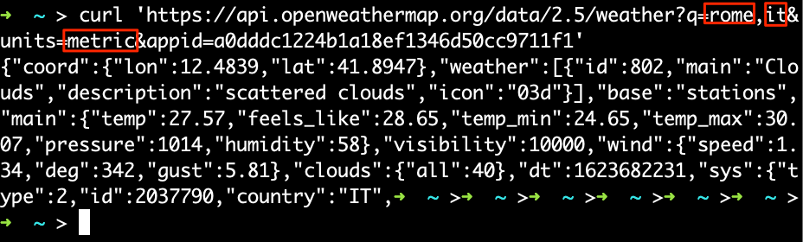
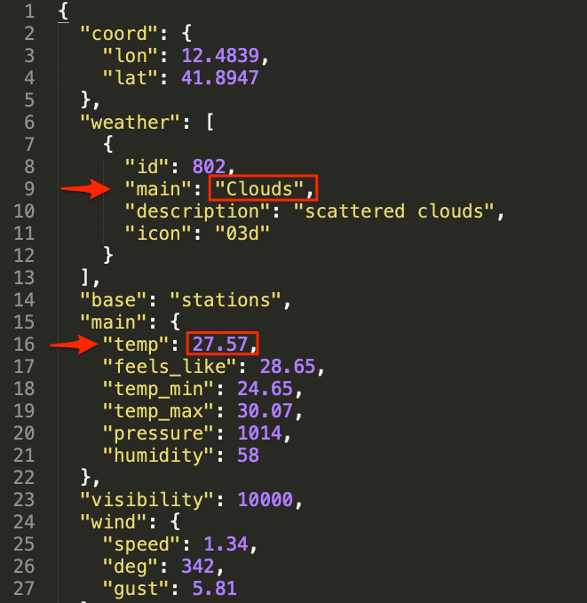
Input/Outputs
User Inputs:
City
Country
Units (metric, imperial)
Desired Outputs:
Weather
Temperature

Slide 8
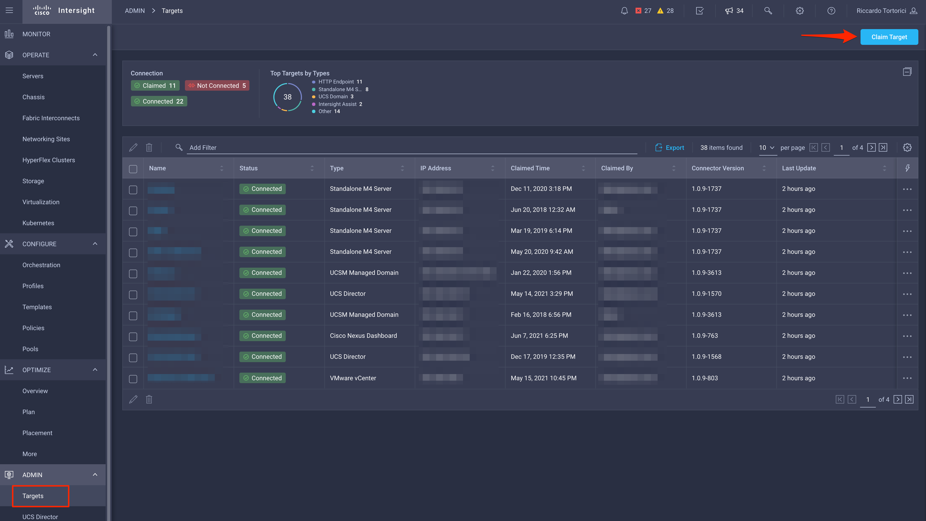
Claim the Target in Intersight
In order to execute automation against any target, you need to claim it.
In our example it will be https://api.openweathermap.org

Slide 9
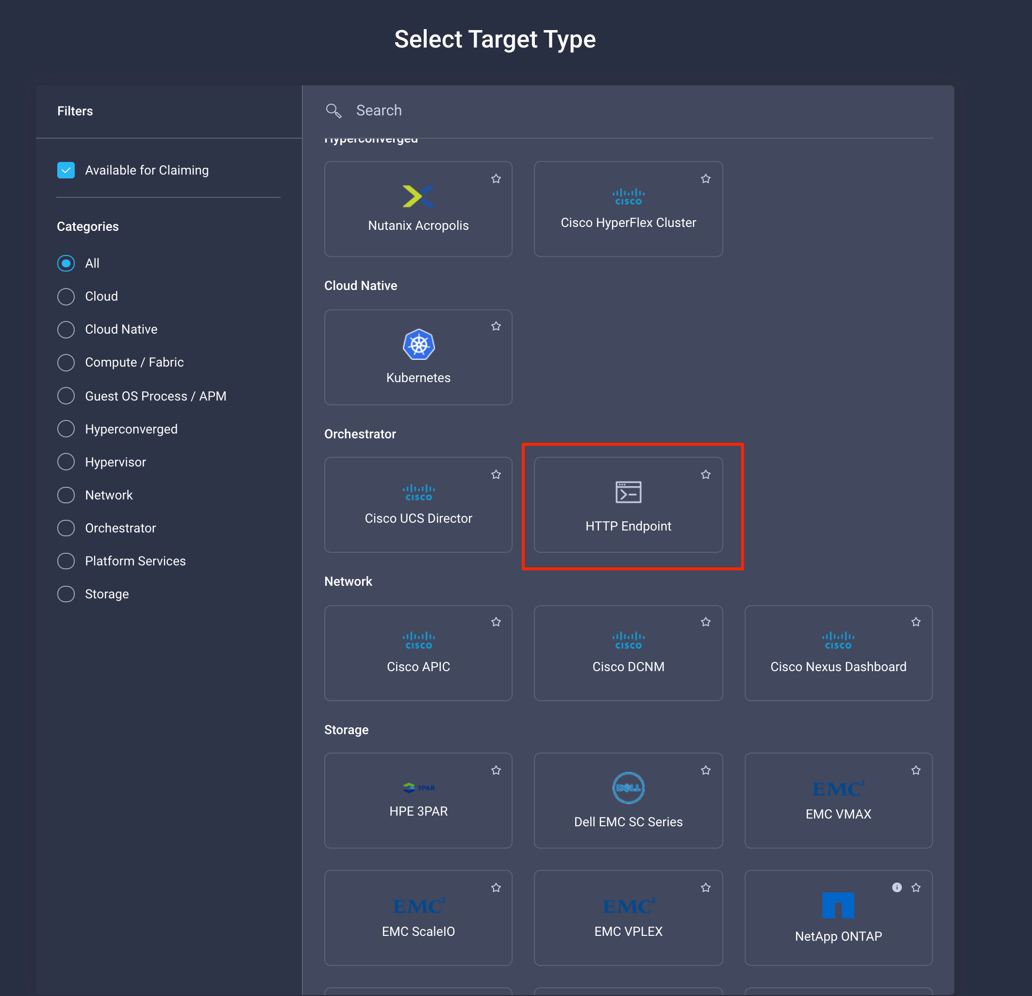
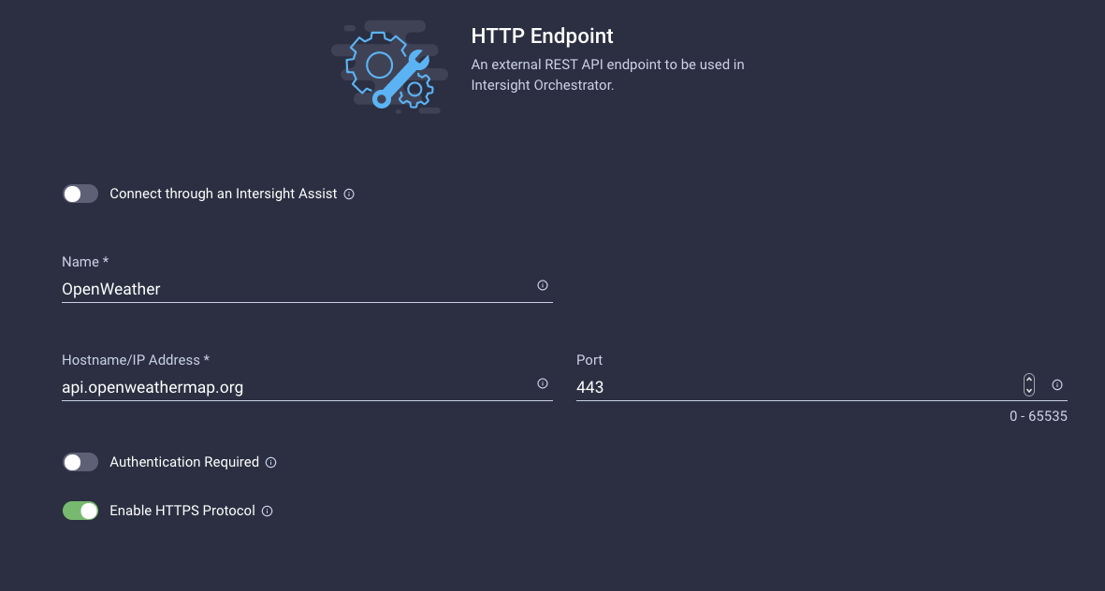
Claim the Target in Intersight
We don’t need to connect through the Assist as the target endpoint is reachable from intersight.com
Once done, click Claim

Slide 10
Custom Data Types (CDTs)

Slide 11
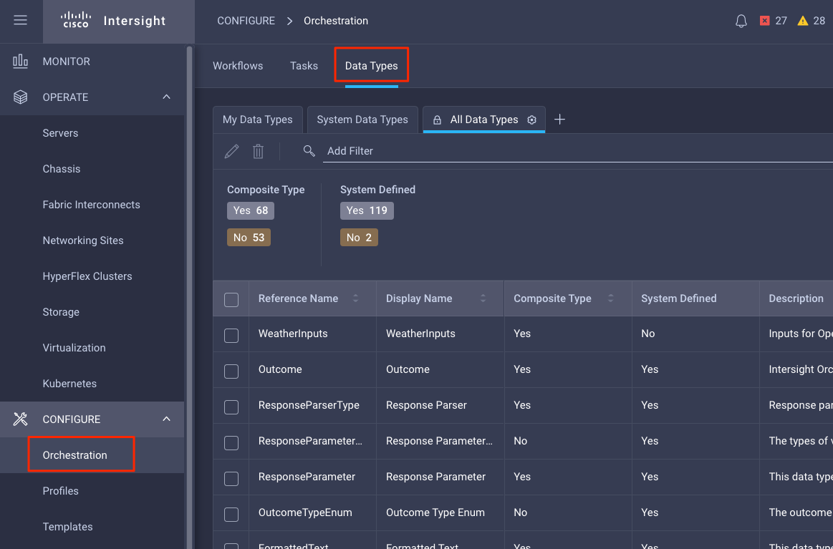
Custom Data Types
Define types and associated constraints and validations
Needed when no other data type fits (i.e. string, int, etc.)
Can be used as workflow inputs

Slide 12
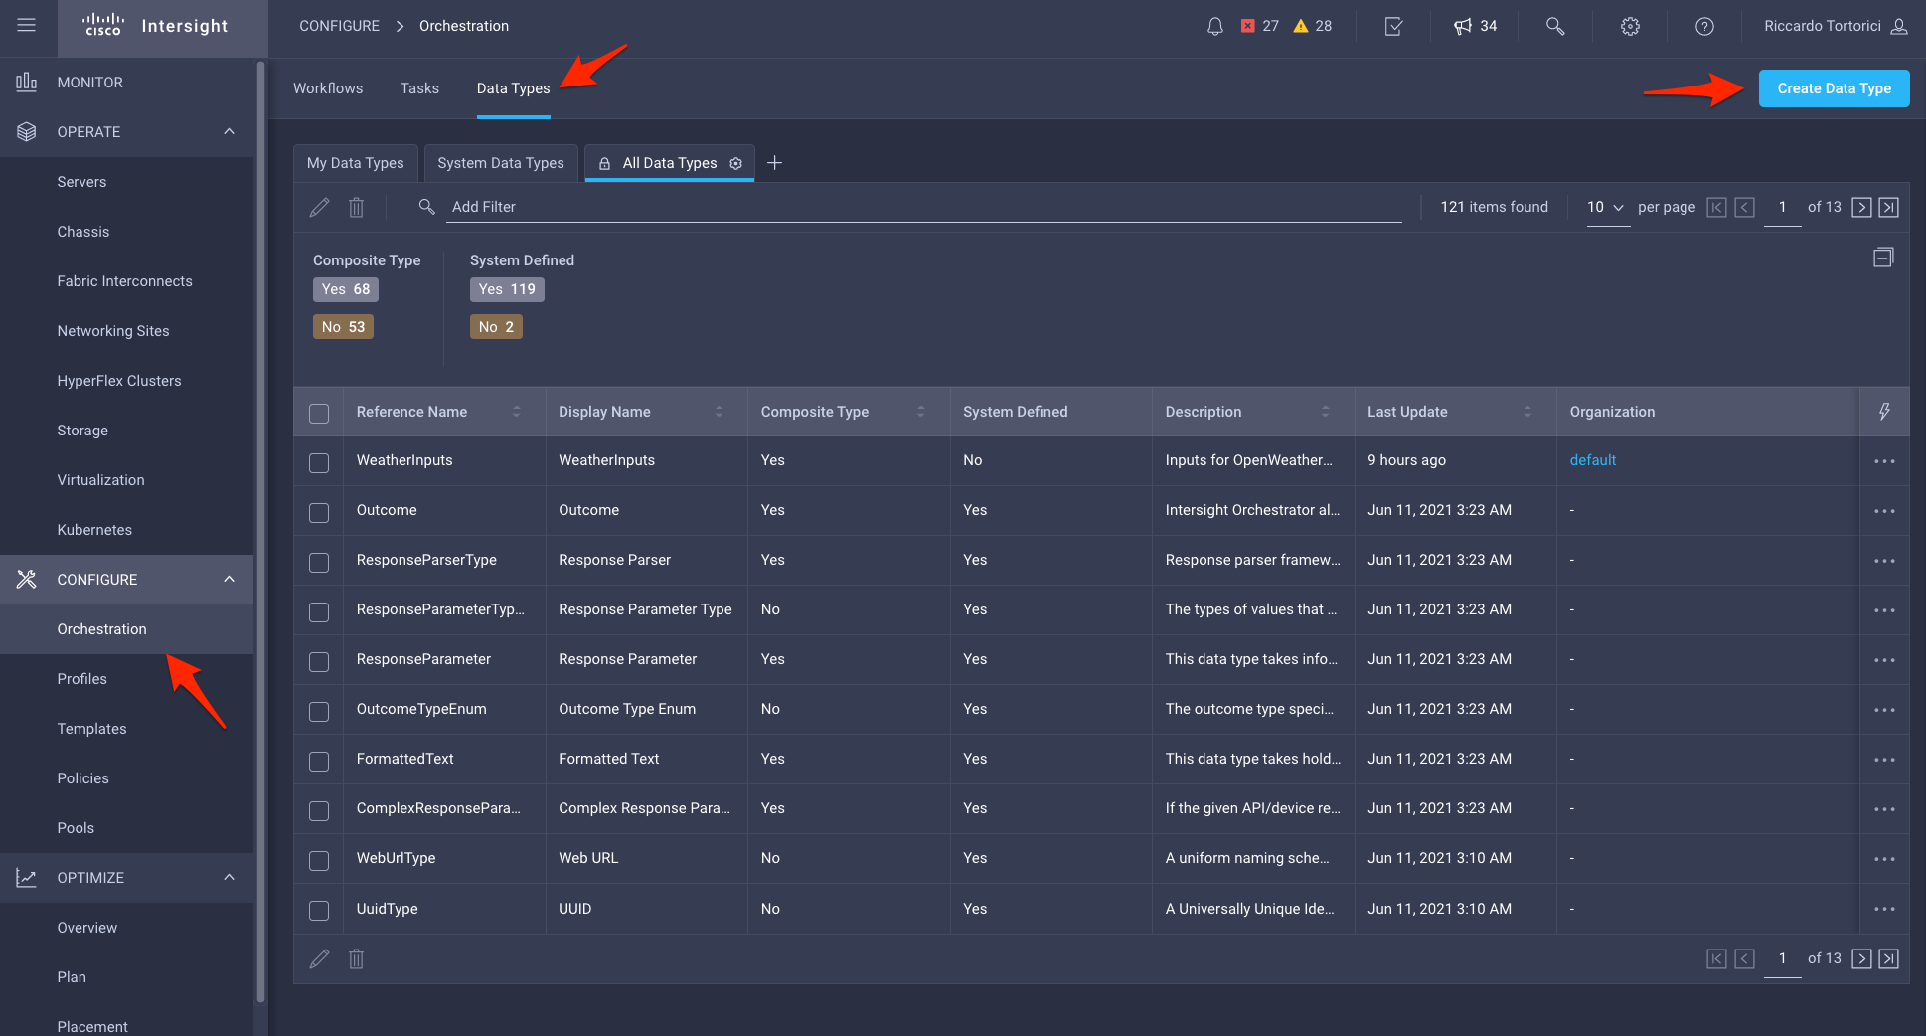
Create a Custom Data Type
We create a new data type that can be used in our main workflow input.
In this case, this new custom data type will include the necessary data to built the API call to openweathermap.org:
City
Country
Units

Slide 13
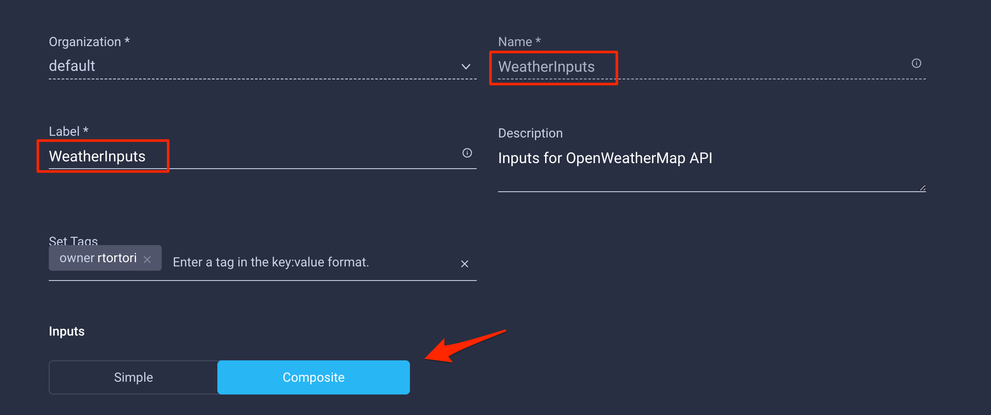
Create a Custom Data Type
We specify a name, a label and a description.
Simple Input:
A simple definition of input. Can be one or a collection of String, Integer, Float, Boolean, JSON or enum
Composite Input:
Multiple combinations of the above

Slide 14
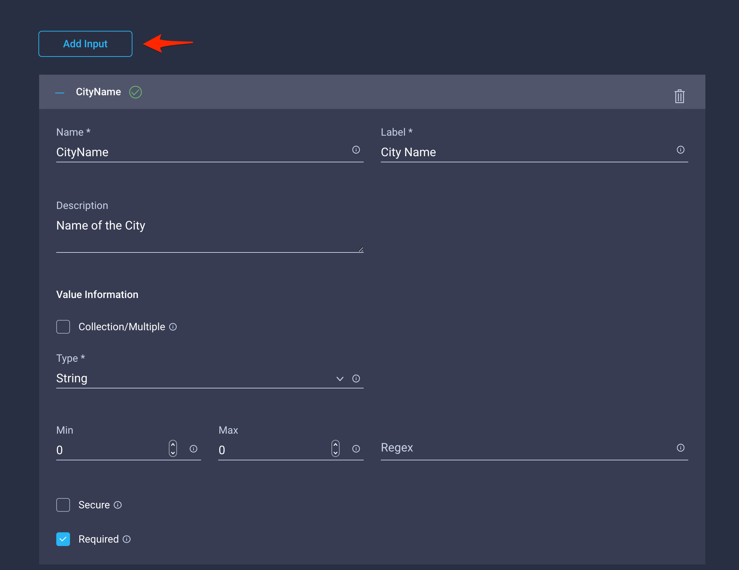
Create a Custom Data Type
The first input will be the name of the city we want the current weather of (CityName)
Type is ‘String’, we do not enforce any constraints/validations (empty regex)
Marked as ‘Required’

Slide 15
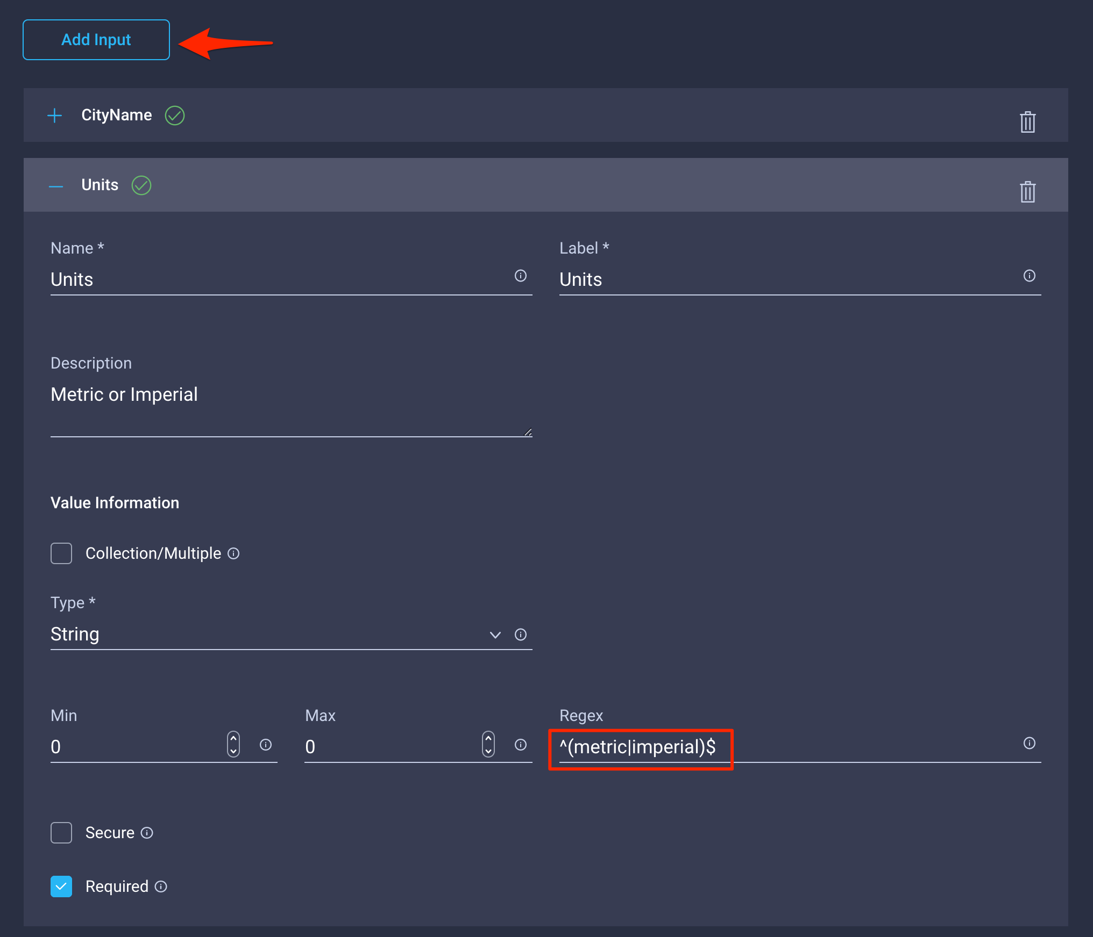
Create a Custom Data Type
The second input will be the units we want to use for the temperature (Units)
Type is ‘String’.
As units can be either ‘metric’ or ‘imperial’ we enforce validation with a regex. Any other value will be invalid.
Marked as ‘Required’

Slide 16
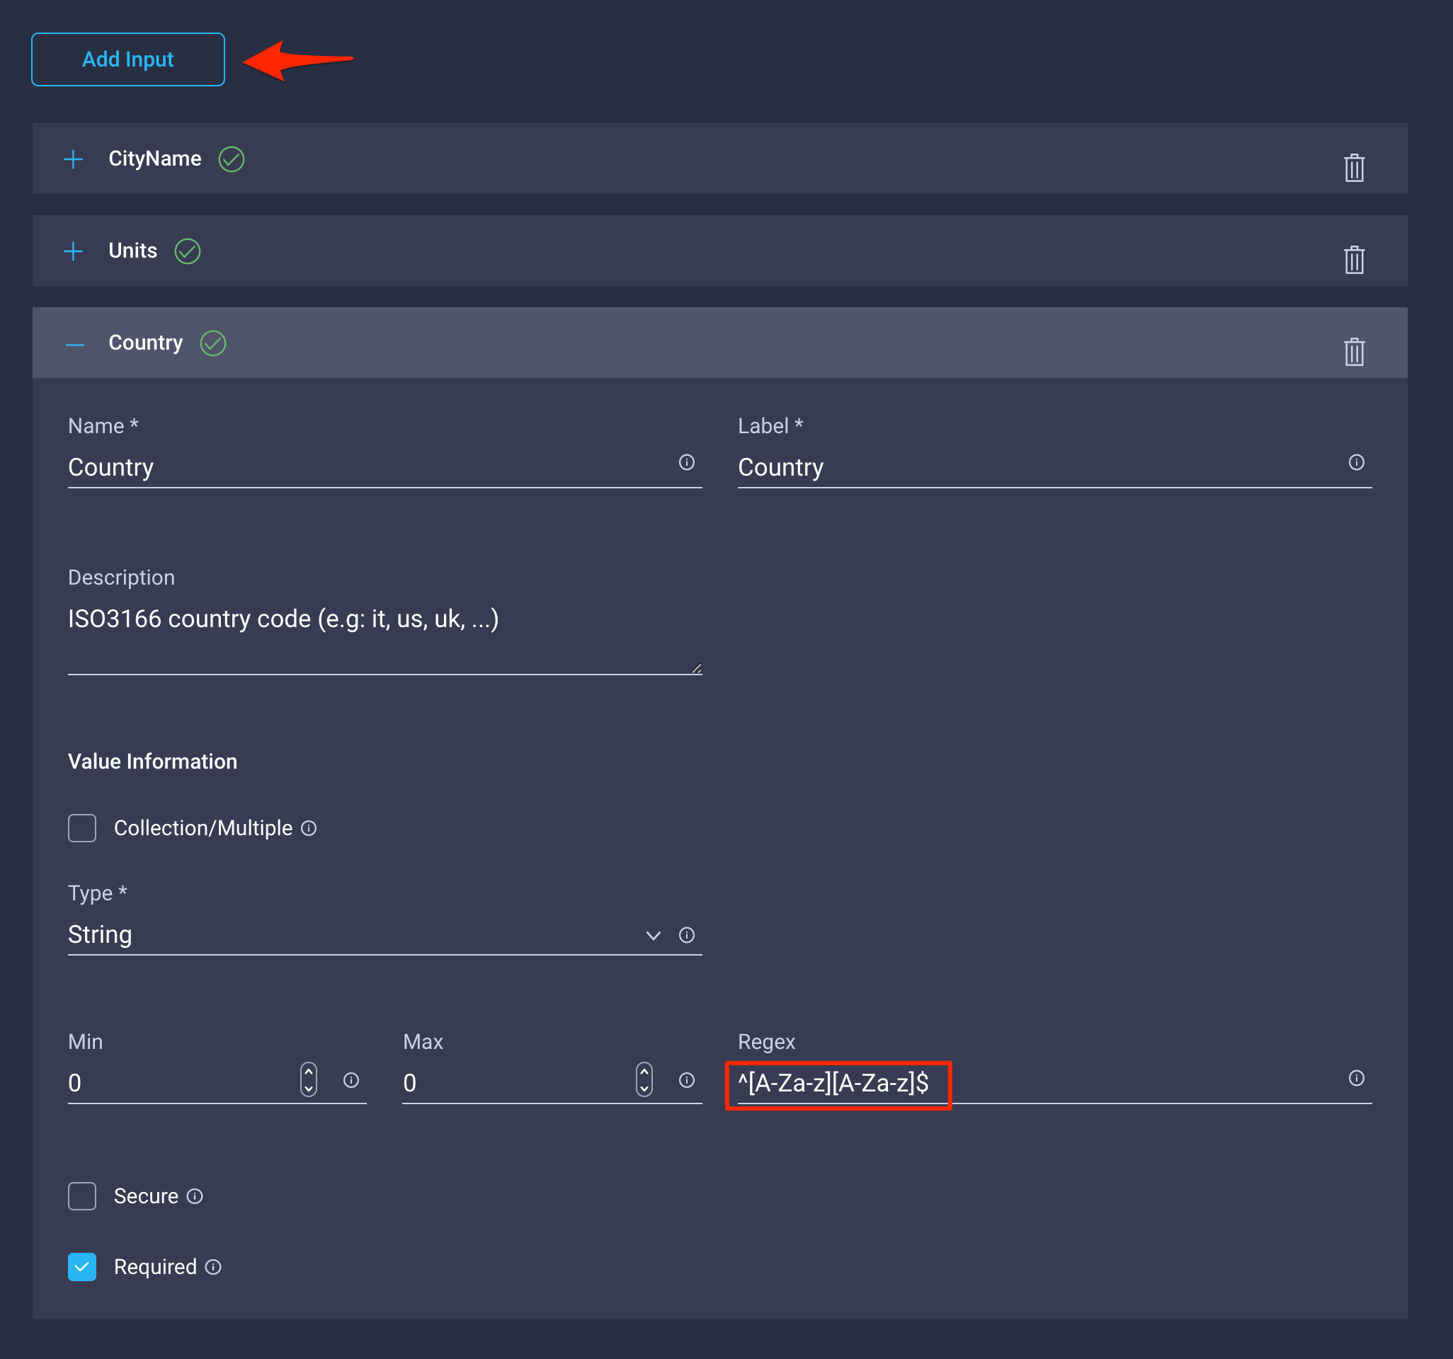
Create a Custom Data Type
The third input will be the country code of the city we are requesting the weather of (Country)
Type is ‘String’.
As we require the country code to be ISO3166 compliant, we enforce validation with a regex. Only two alphabetic characters (case insensitive) will be accepted.
Marked as ‘Required’
Ref. (Alpha2): https://www.iso.org/obp/ui/#iso:pub:PUB500001:en

Slide 17
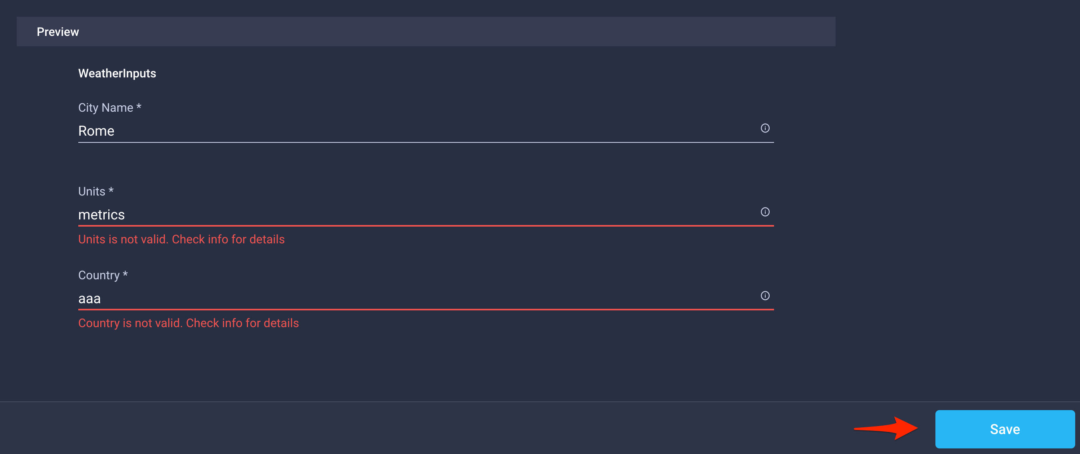
Preview a Custom Data Type
The Preview section allows the user to test their validation regex. Hit ‘Save’ when done

Slide 18
Task Designer

Slide 19
Web API Executor and Outcomes

Slide 20
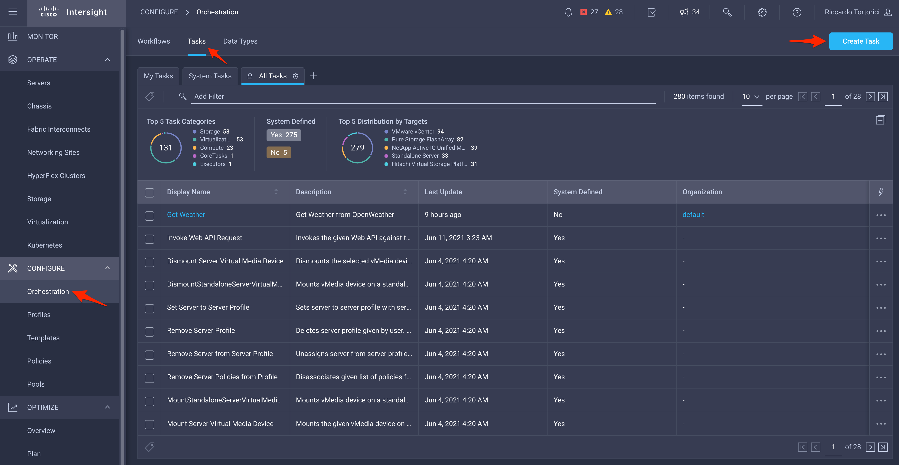
Create a Custom Task in the Task Designer
This custom task will be responsible to query openwheather and fetch the weather details.
It will use the WeatherDetails CDT and can be reused in any workflow

Slide 21
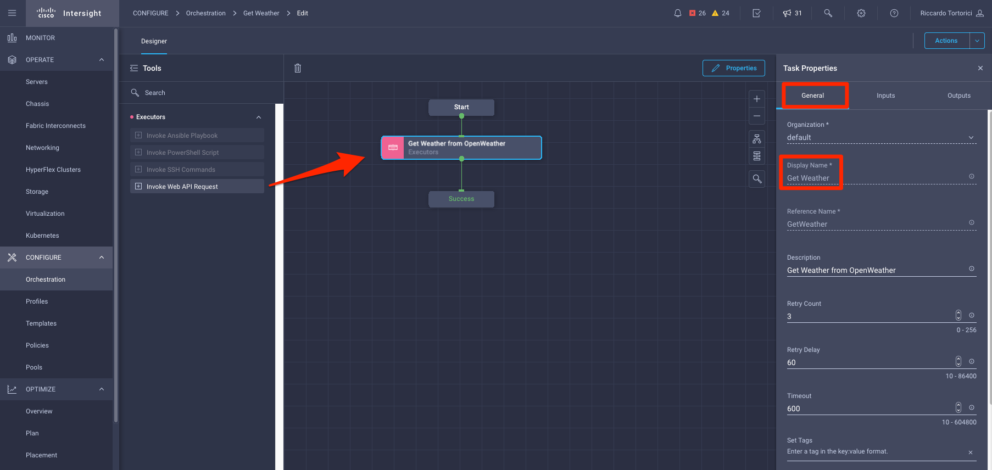
Create a Custom Task using the Web API Executor 1/9
Drag the web API Request task in the central pane and connect the ‘Start’ and ‘Success’ blocks to it.
Select an organization and give the task a name (Get Weather).

Slide 22
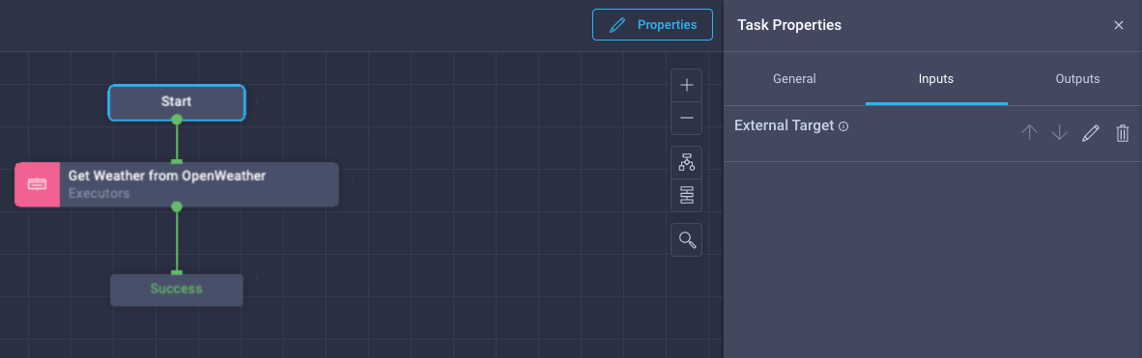
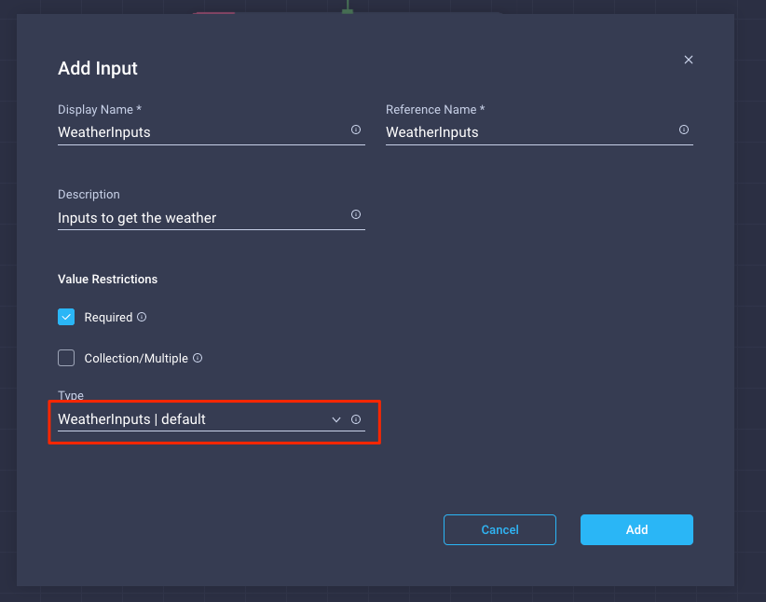
Create a Custom Task using the Web API Executor 2/9
Drag the web API Request task in the central pane and connect the ‘Start’ and ‘Success’ blocks to it.
Select an organization and give the task a name (Get Weather).
Click ‘Create Task Input’.
Specify a Display Name as well as a Reference name (WeatherInputs).
Mark it as ‘Required’.
For the data type, we are going to use our Custom Data type WeatherInputs

Slide 23
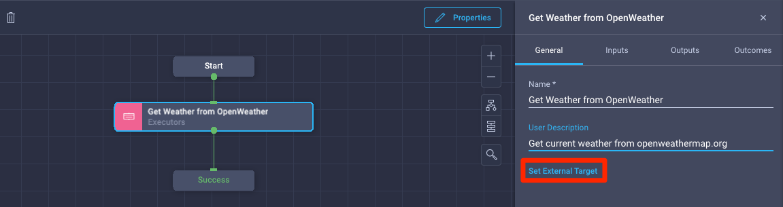
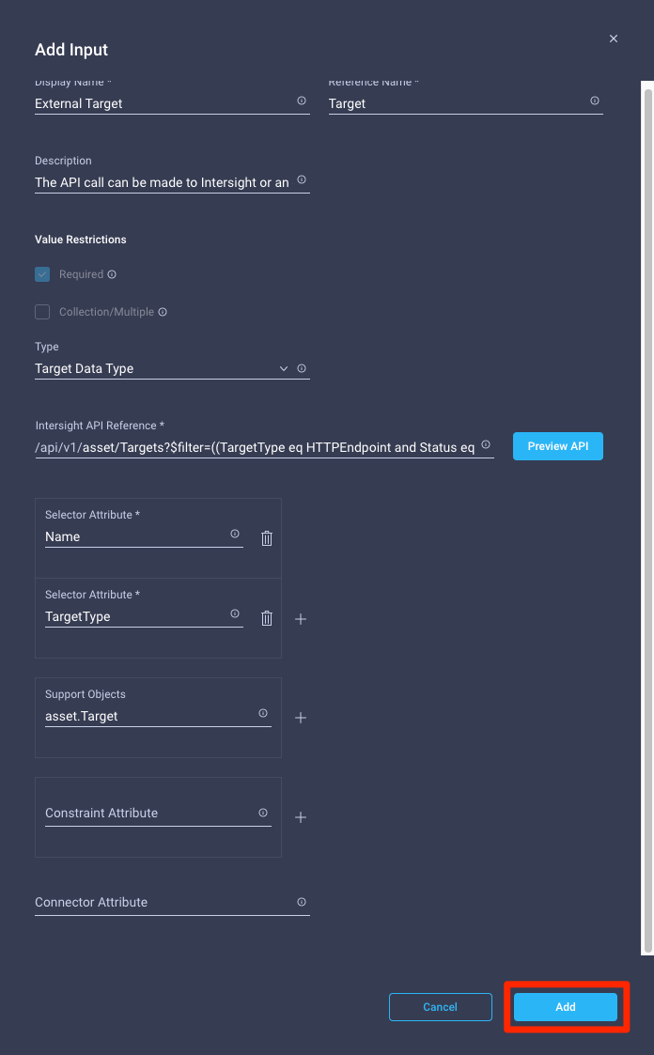
Create a Custom Task using the Web API Executor 3/9
Click on the executor task, then click on ‘Properties’. Give the executor a name (Get Weather from OpenWeather) and set the external target. This option will allow to execute API calls against external endpoints as by default those calls will hit the Intersight API.
Click Add to confirm the default Target Types, this will include all valid targets you can run API calls against.
These are currently: HTTP endpoint, Pure Storage, NetApp, Hitachi, Terraform Cloud, vCenter, MDS, Nexus and Cisco APIC

Slide 24
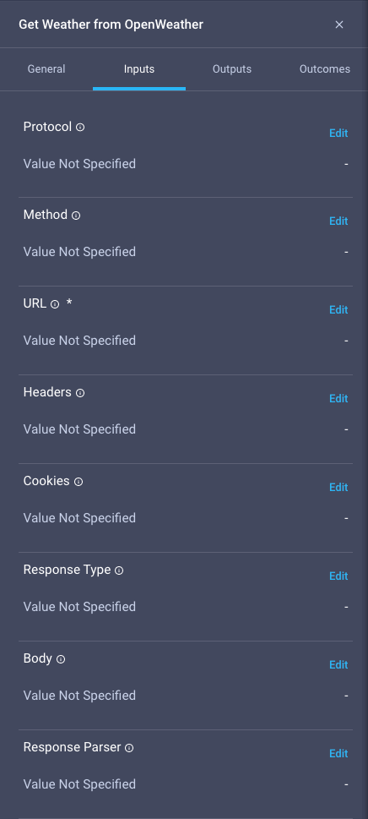
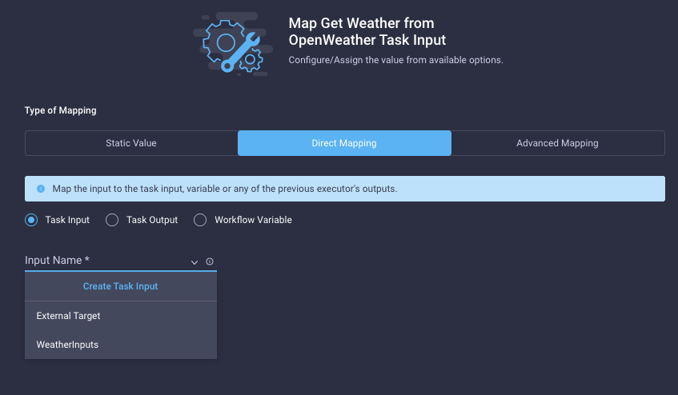
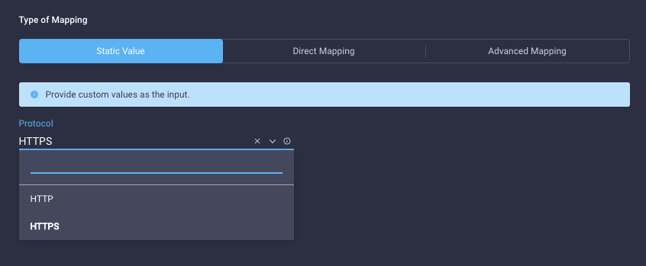
Create a Custom Task using the Web API Executor 4/9
Inputs Tab
Click on ‘edit’ to set a value for each input of this task. The ‘i’ icon will provide detailed information of each input as well as the default value.
When you click on ‘edit’, you can either map an existing task input, create a new one or set a custom value

Slide 25
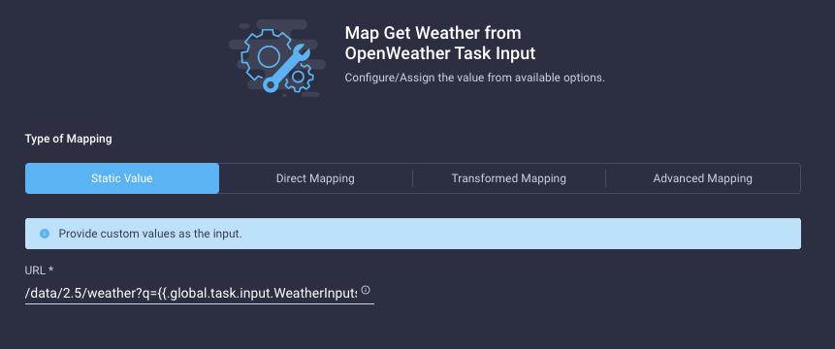
Create a Custom Task using the Web API Executor 5/9
Edit the ‘URL’ input. This is a relative URL that gets appended to the target (in this case openwheather), not an FQDN.
We set a Static Value.
We want to replicate exactly the same call we did with curl:
$ curl 'https://api.openweathermap.org/data/2.5/weather?q=rome,it&units=metric&appid=a0dddc1224b1a18ef1346d50cc9711f1'
Fill in with the following (replace with your own OpenWeather API key):
/data/2.5/weather?q={{.global.task.input.WeatherInputs.CityName}},{{.global.task.input.WeatherInputs.Country}}&units={{.global.task.input.WeatherInputs.Units}}&appid=a0dddc1224b1a18ef1346d50cc9711f1
Everything between {{ }} will be replaced dynamically:
.global.task.input.WeatherInputs.CityName
One of the custom task input
Name of the Input
Key in the input

Slide 26
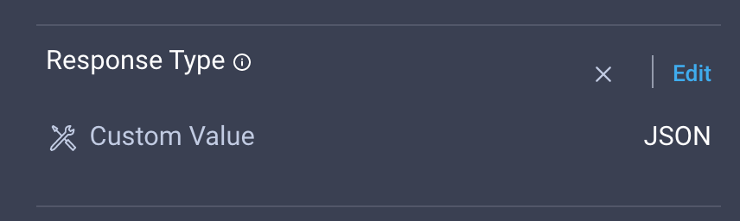
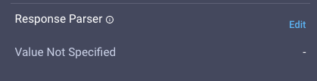
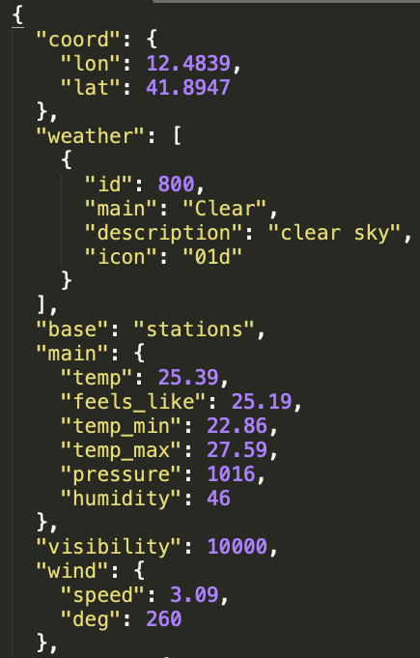
Create a Custom Task using the Web API Executor 6/9
Set the ‘Response Type’ to JSON
The response parser is going to extract and manipulate the response from the target. In our case we want to extract the weather conditions and the temperature
Openweathermap response example

Slide 27
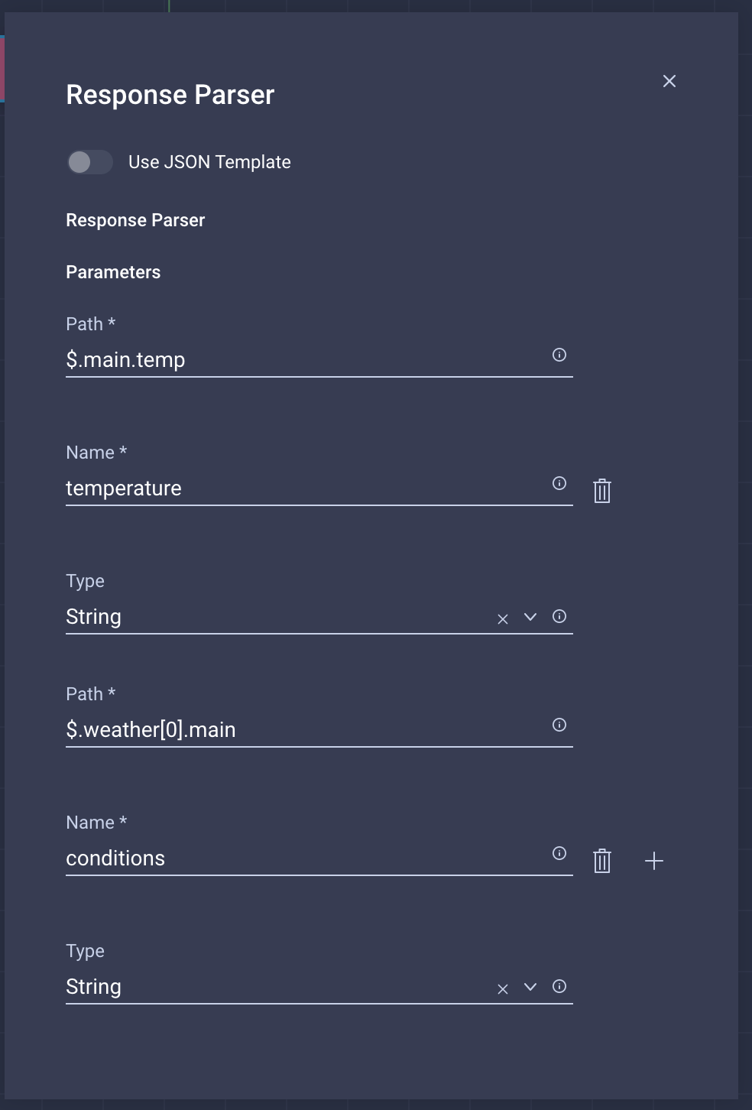
Create a Custom Task using the Web API Executor 7/9
Set the jsonpath of the value you want to extract from the response.
In the example:
$.main.temp will extract 25.39 as a string and set this value to the parameter task output with ‘Name’ = temperature
$.weather[0].main will extract ‘Clear’ from the ‘main’ key on the first array element [0] of the ‘weather’ key. The value will appear in the parameter task output with ‘Name’ = conditions
Click the plus (+) sign to add more parameters

Slide 28
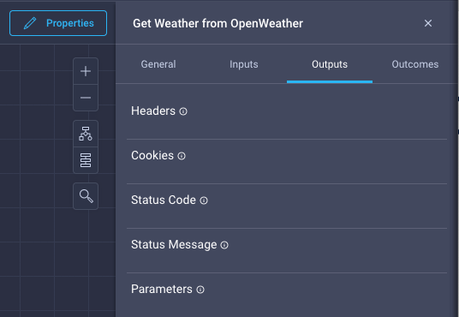
Create a Custom Task using the Web API Executor 8/9
In the task output tab, there is a list of predefined
Outputs. The response parser will put the extracted values using the names specified. In our example, temperature and conditions respectively.
These are normal task outputs and can be leveraged elsewhere in ICO

Slide 29
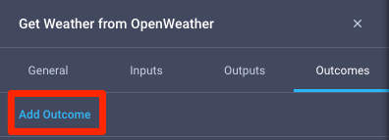
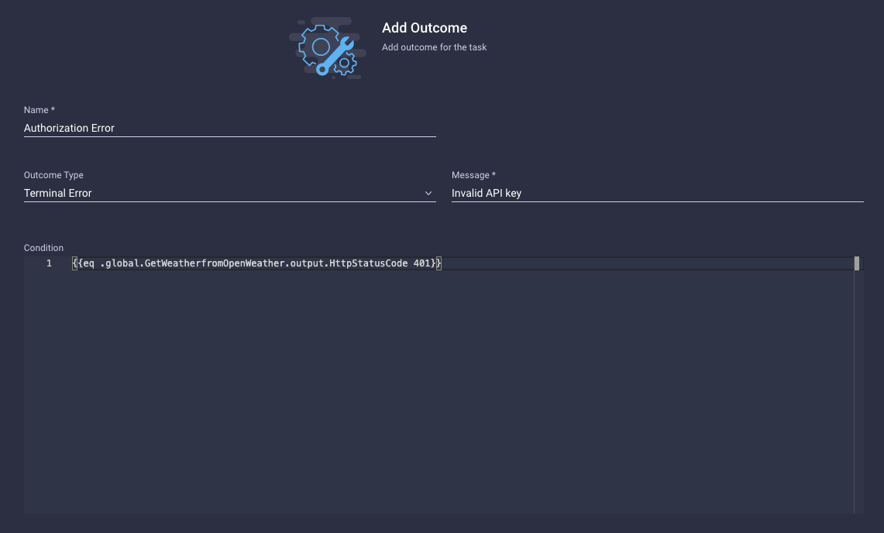
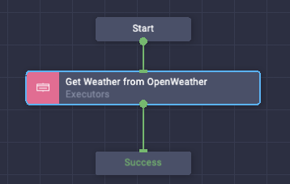
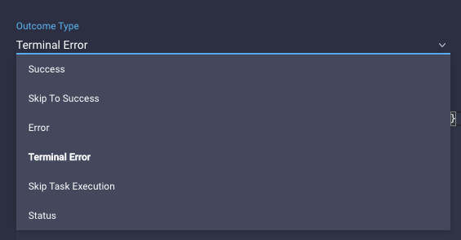
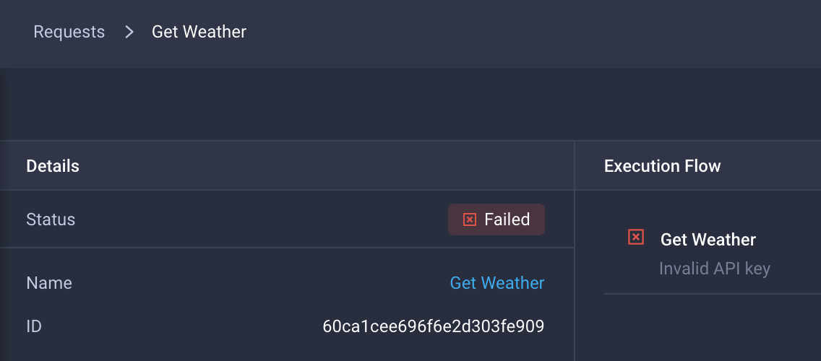
Task Outcomes
A task outcome defines how the task behaves based on configurable conditions.
In the example:
{{eq .global.GetWeatherfromOpenWeather.output.HttpStatusCode 401}}
Checks whether the HttpStatusCode task out is 401. If that’s the case, we return a Terminal Error with the custom Message “Invalid API key”
Where GetWeatherfromOpenWeather is the name
of the task with no spaces.
{{eq .global.GetWeatherfromOpenWeather.output.HttpStatusCode 401}}

Slide 30
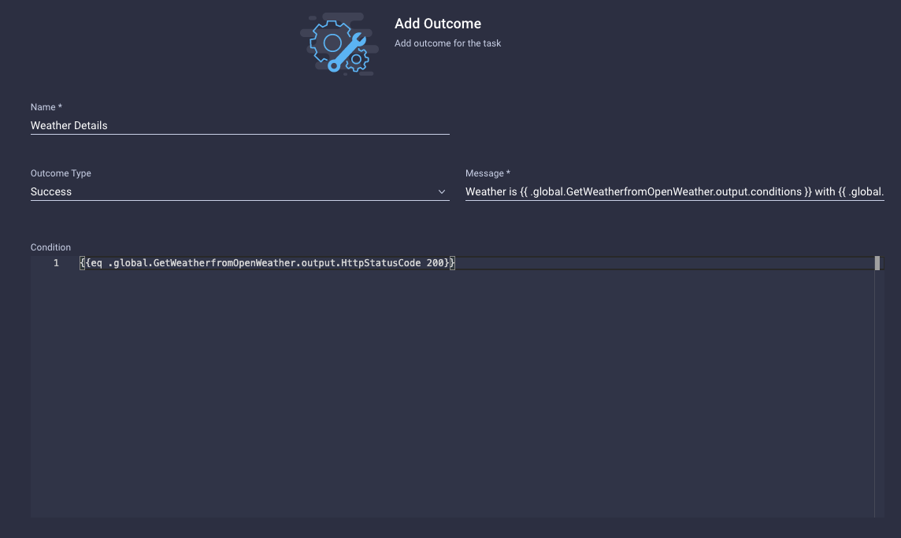
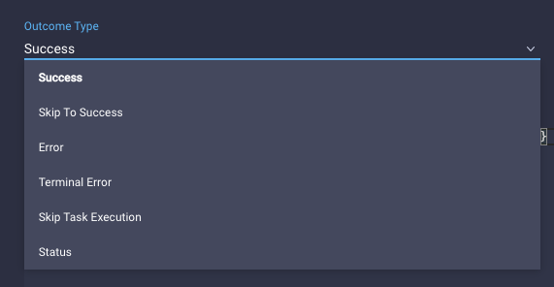
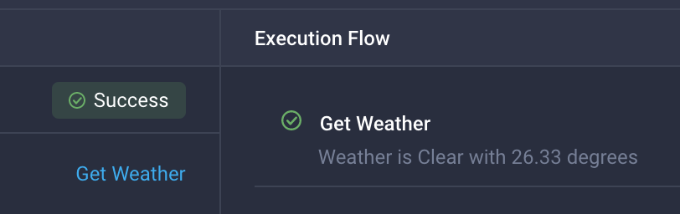
Task Outcomes
We are going to add one more task outcome.
In the example:
{{eq .global.GetWeatherfromOpenWeather.output.HttpStatusCode 200}}
Checks whether the HttpStatusCode task out is 200. If that’s the case, we succeed with the custom Message “Weather is {{ .global.GetWeatherfromOpenWeather.output.conditions }} with {{ .global.GetWeatherfromOpenWeather.output.temperature }} degrees
”
We can use the task outputs to customise the Message.
Assuming the output conditions to be “Clear” and the temperature to be “26.33” the message would look like this:
“Weather is Clear with 26.33 degrees”
{{eq .global.GetWeatherfromOpenWeather.output.HttpStatusCode 401}}

Slide 31
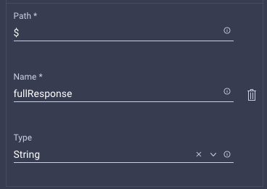
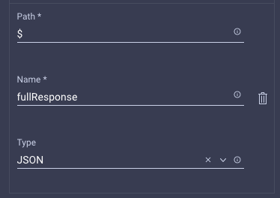
Additional Outcome Expression Examples
Let’s assume the sample scenario where you want to make a task fail if the server returns an empty response (example: "[]")
As of February 2022, ICO doesn’t store the full response by default.
You will need to create a parameter from the Response parser that stores the full response using ‘$’ as JSONPATH.
In this example, it will be called fullResponse
Case 1 – Full Response as String
Here we want to trigger the outcome if the returned payload string is equal to "[]"
Outcome Condition
Type: Terminal Error
Message: ‘Response is empty’
Condition:
{{eq .global.InvokeGenericWebApi1.output.fullResponse "[]"}}
Case 2 – Full Response as JSON
Here we want to trigger the outcome if the returned payload has zero elements in the array
Outcome Condition
Type: Terminal Error
Message: ‘Response is empty’
Condition:
{{eq (len .global.InvokeGenericWebApi1.output.fullResponse) 0}}

Slide 32
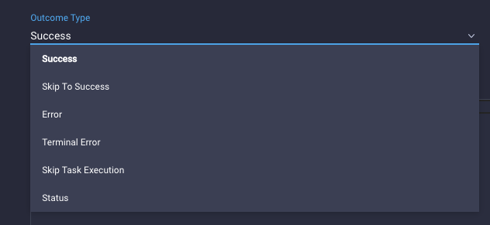
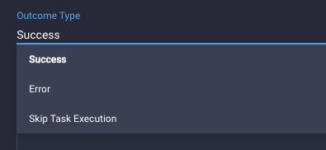
Outcomes Deep Dive
Depending whether you are using an executor as an embedded task or you are building a reusable custom task, you will have different outcome types available.
Custom Task
Embedded Task

Slide 33
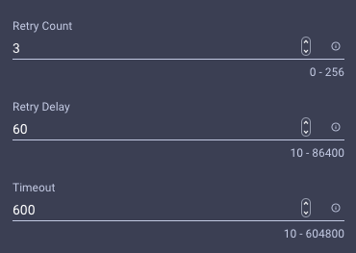
Retry Parameters
Outcomes use retry parameters to define the behavior of a single executor or the whole custom task.
Retry parameters are available only for custom tasks created in the Task Designer (General Tab) and are predefined (not configurable) in the Workflow Designer.
Note: Retries are global to the custom task, this means that the amount of retries are shared among all tasks in a custom task. If a single task consumes all retries, there will be no more retries left for subsequent tasks
Name | Description | Default | Notes
Retry Count | The number of times a task should be tried before marking as failed | 3 | Not Configurable in Workflow Designer
Retry Delay | The delay in seconds after which the the task is re-tried | 60 | Not Configurable in Workflow Designer
Timeout | The timeout value in seconds after which task will be marked as timed out. Max allowed value is 7 days | 600 (120 for embedded tasks) | Timeout is set to 120 in the Workflow Designer, not configurable by the user
Retry Policy | Can be Fixed (Retry happens after a specific amount of time) or BackOff | Fixed | Backoff* currently not supported (as of April 2022)
* Backoff will allow delay to increase between retries

Slide 34
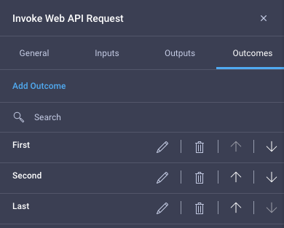
Order of Operations
Outcomes are evaluated sequencially, order matters!
If no outcome will be matched, the task will follow its default behaviour, that is timing out or success.

Slide 35
Outcome Types
Outcome Type | Description | Availability
Success | Task will succeed if condition evaluates to true | TD and WD
Skip To Success | If the condition matches, all subsequent API in a custom task will be skipped and go directly to Success block | Task Designer Only
Error | If the condition matches the whole custom task will be retried assuming there are retries left | TD and WD
Terminal Error | If the condition matches, retry count will be ignore and the whole task will be marked as failed | Task Designer Only
Skip Task Execution | If the condition matches the whole task will be skipped | TD and WD
Status | If the condition matches the whole custom task will be retried (assuming there are retries left), however the user will not be notified about the fail. A user would use the status outcome type when the target is returning a response representing an ongoing activity and they want to retry until the response matches a condition. For instance, retry an API that returns {"Status": "Creating"}until it returns {"Status": "Completed"} | Task Designer Only

Slide 36
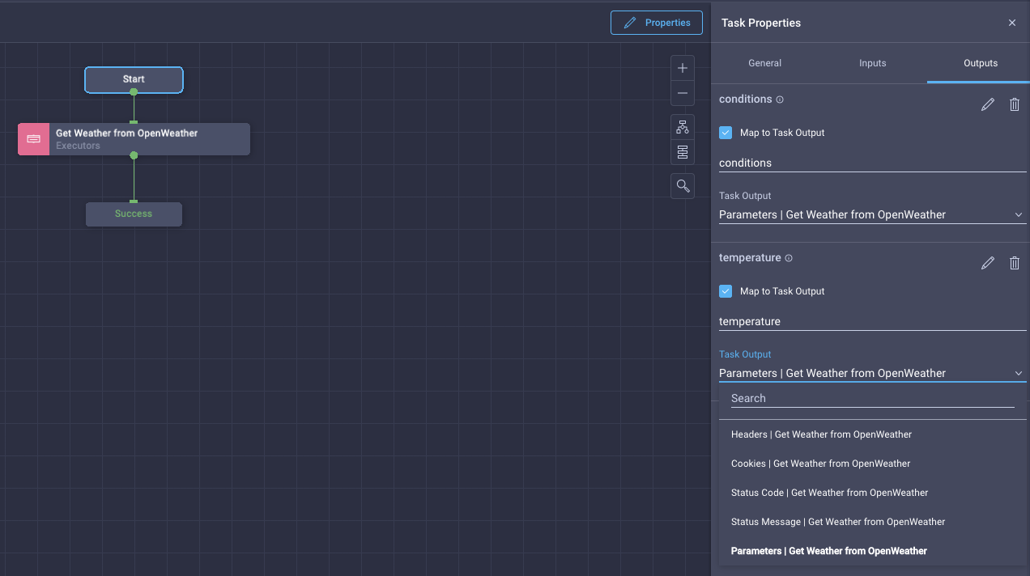
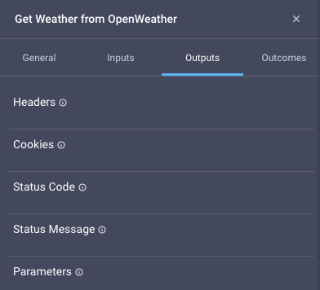
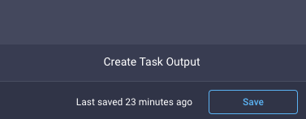
Create a Custom Task using the Web API Executor 9/9
Click on ’Start’, then ‘Properties’ to get the overall task (workflow) properties.
To set the overall task Outputs, click on the Outputs tab.
You can map outputs to task outputs.
Click on the Task Output dropdown menu, these are the task outputs that can be selected. Selecting Parameters, we can access the outputs created by the response parser.
Create outputs for both
conditions and temperature.
In this example, the name of the outputs matches the keys we used to represent the values extracted by the response parser
Output name
Path: name as configured in the Response Parser
Task outputs
When done, click the Save button

Slide 37
Workflow Designer

Slide 38
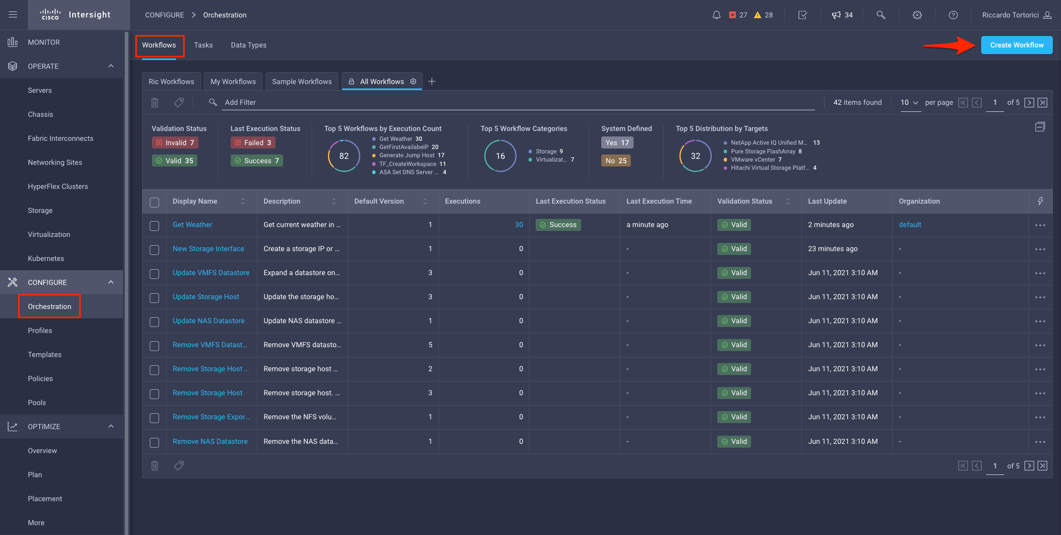
Create a Workflow

Slide 39
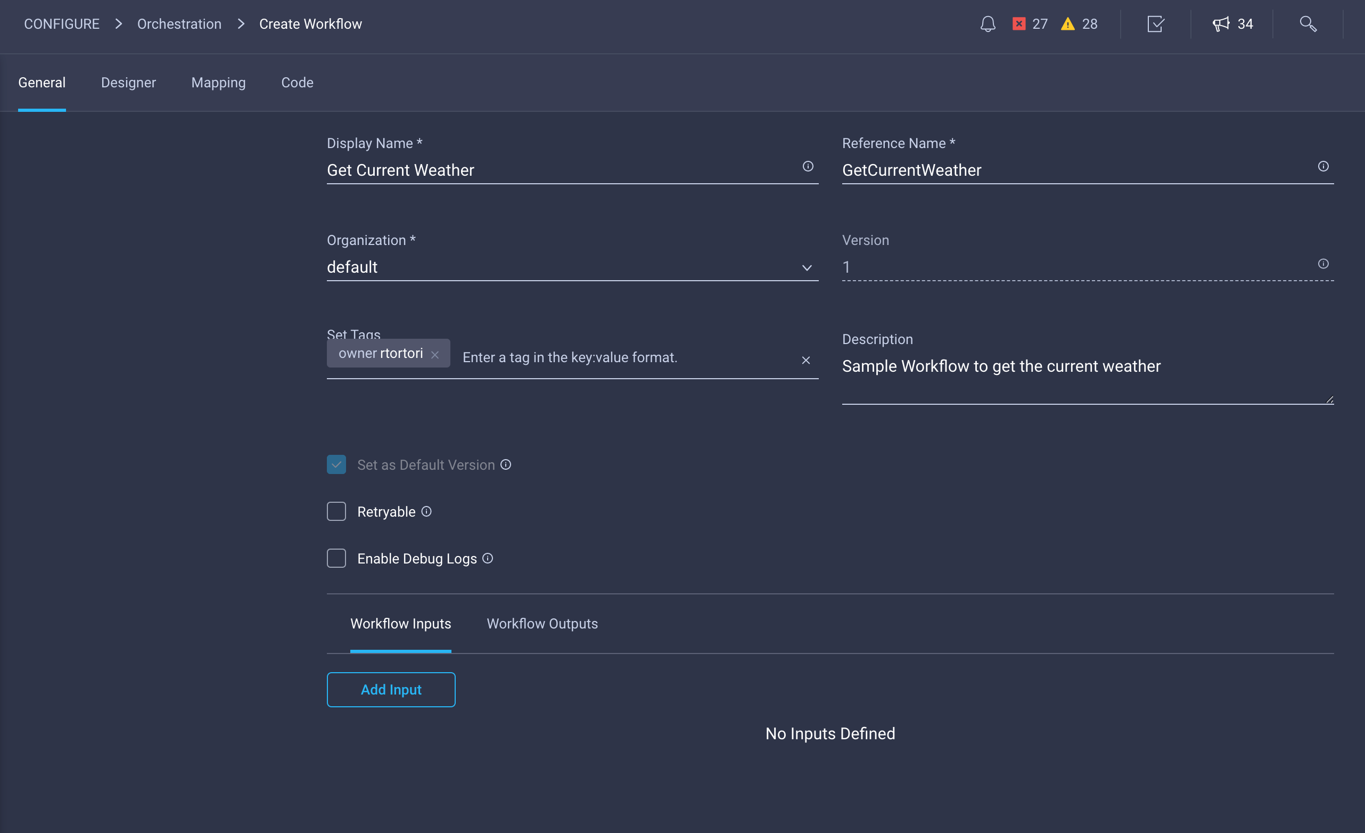
Create a Workflow
We are going to create a workflow that gets the current weather in a given city and country.
In the General tab, we give the workflow a Display Name as well as a Reference Name which will be used to reference this workflow within ICO.
Clicking on Add Input, we want to add 3 inputs:
City
Country
Units

Slide 40
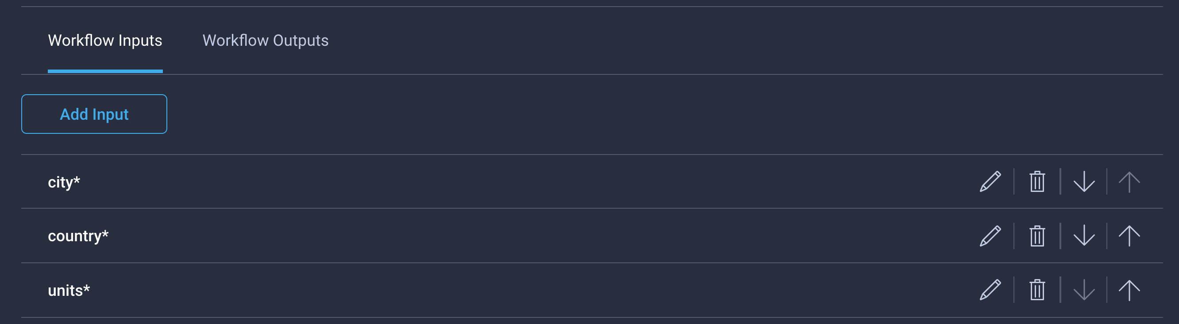
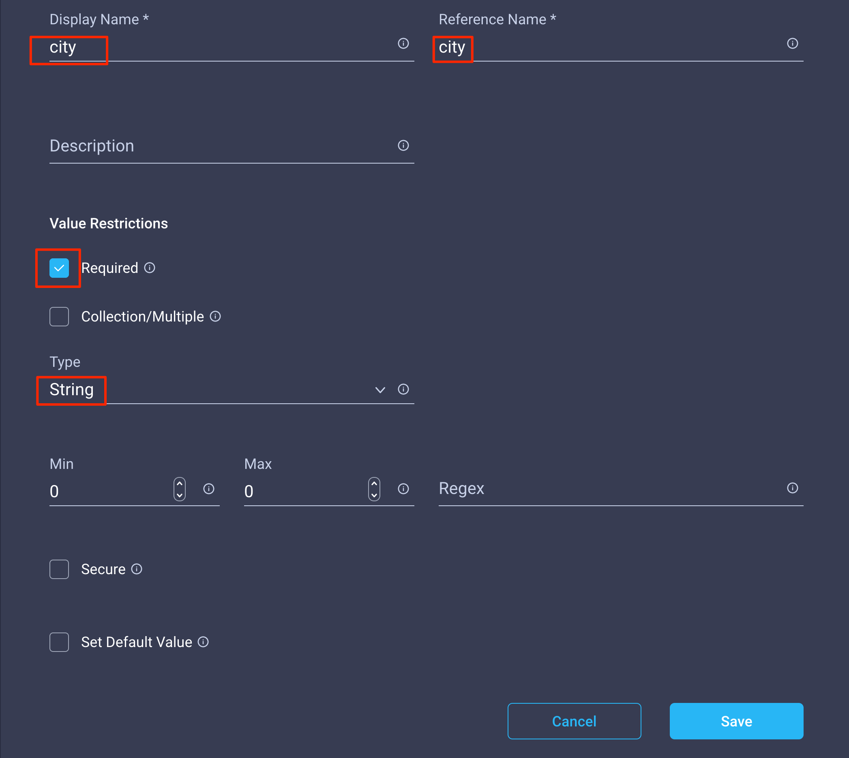
Create a Workflow
All three inputs are Required with Type = String
You can also set a Default Value if needed.
Note that currently (June 2021) the input validation for CDTs is enforced only if using Static Mapping. Direct Mapping of individual inputs to CDT parameters is not currently supported in the UI while advanced Mapping ignores CDT input validation
This means that for workflows requiring advanced mapping, the user is responsible to enforce regexp validation also at the workflow input level

Slide 41

Create a Workflow
In the Designer tab, drag the ‘Get Weather’ custom task we created in the palette.
Connect the Start block to the green connector of the custom task, as well as the Success block as shown.

Slide 42

Create a Workflow
Clicking on the Inputs tab on the ‘Get Weather’ task properties, we can find two inputs are required:
The external API target endpoint
WeatherInputs, our Custom Data Type

Slide 43


Create a Workflow
On External Target, click on Edit.
You can map the external target using a Static Value (the workflow will always execute against this target), Direct Mapping (map to an existing workflow input or task output) or Advanced Mapping (leverage Go templates for advanced mappings/transformations)
Click on Select External Target to statically map the input to the ‘OpenWeather’ target

Slide 44


Create a Workflow
On WeatherInputs, click on Edit.
The default static value mapping will give you the opportunity to hardcode the three required values of the CDT. However, since we want them to be mapped to the workflow input (in order for the user to execute the workflow for multiple cities) and there is currently no way in the UI to map individual inputs to CDT properties, we are going to select Advanced Mapping

Slide 45



Create a Workflow
Custom Data Type
Workflow Inputs
The WeatherInputs CDT we created has three properties:
CityName
Units
Country
This Go Template maps each CDT parameter to specific workflow inputs.
Refer to the documentation for additional details on Template Parameters:
https://www.intersight.com/help/resources/web_api_request#template_parameters
{
"CityName": "{{.global.workflow.input.city}}",
"Units": "{{.global.workflow.input.units}}",
"Country": "{{.global.workflow.input.country}}"
}

Slide 46


Create a Workflow
Recall: we have set two outputs on the custom tasks:
conditions
temperature
Add two Workflow Outputs named ‘conditions’ and ‘temperature’ then map them to appropriate ‘Parameters’ task outputs

Slide 47
Validate and Execute a Workflow

Slide 48


Validate and Execute the Workflow
Select an organization, the required inputs of the workflow should now appear.
Fill in the details with your favourite city, country (ISO3166) as well as the units (metric or imperial).
Click on Execute
Save the workflow. The system will perform validation checks.
Once done, click on Execute to run the workflow

Slide 49


Validate and Execute the Workflow
Right after the execution you’ll move to the History tab of the workflow.
Here you can check details of all workflow executions
Here is the status of the selected execution
Shows Debug Logs (if enabled in the workflow under the General tab) for deeper inspection or troubleshooting. Example: TargetURL, Headers, ContentType, Outcomes, etc.

Slide 50


Validate and Execute the Workflow
The Inputs fields will display the workflow inputs value used in this specific execution
The Outputs fields will display the workflow outputs.
You can concatenate outputs to other task inputs

Slide 51


Validate and Execute the Workflow
The Code tab displays the generated code for this workflow.
There will eventually be the ability to live edit the code.
For now it's there to use as reference for things you can’t see in the UI, such as unique names of the task blocks as they're put on the canvas
Clicking on the ‘terminal’ icon in the upper right corner, will open the REST API docs for the workflows directly, where you can optionally copy the current code and make modifications

Slide 52



Validate and Execute the Workflow
View all will display all Requests
You can select one or multiple Requests and execute actions

Slide 53

Validate and Execute the Workflow
Clicking on one Request, you will get its Execution Flow, which will display outcomes for each tasks and external workflows invoked in this execution. In this case, we had a single task in our workflow but you can nest multiple workflows and use them as atomic tasks.

Slide 54
Use Task Outputs as Inputs for other Tasks

Slide 55



Modify Custom Tasks – Response Parser
Scope: extract from API response the ‘longitude’ and ‘latitude’
In the custom task, we edit the Response Parser to extract two additional parameters

Slide 56


Modify Custom Tasks – Custom Task Outputs

Slide 57


Check New Task Outputs
A new execution highlights the new task outputs.
Note: Workflow Outputs still shows the original outputs

Slide 58



Create a New Task to Get Detailed Info - 1/3
Create one output named ‘humidity’.
This will be mapped to the humidity response parser
Name: ‘Get Forecasts’
All inputs as Strings.

Slide 59

Create a New Task to Get Detailed Info - 2/3
Executor properties.
Name: ‘Get Forecast’
Set External Target checked (calls will run against the same target)

Slide 60



Create a New Task to Get Detailed Info - 2/3
This call requires latitude and longitude. They will be mapped to the latitude and longitude outputs of the ‘Get Weather’ task within the main workflow.
/data/2.5/onecall?lat={{.global.task.input.latitude}}&lon={{.global.task.input.longitude}}&units={{.global.task.input.units}}&appid=a0dddc1224b1a18ef1346d50cc9711f1
Response parser is extracting the current humidity and store in the ‘humidity’ parameter as a string
Save once done

Slide 61

Add New Tasks to an Existing Workflow
In the main workflow, drag the new ‘Get Forecast’ task in the designer right below the ‘Get Weather’ task

Slide 62

Add New Tasks to an Existing Workflow
The ‘Get Forecast’ tasks wants four inputs:
External Target – it will be the same target we claimed for the weather
Latitude – we get this value from the previous task output
Longitude – we get this value from the previous task output
Units – we get this value from the workflow input

Slide 63

Add New Tasks to an Existing Workflow
External Target will be a static mapping

Slide 64

Add New Tasks to an Existing Workflow
For the latitude, we want the value to be the output of the previous task (‘Get Weather’)

Slide 65

Add New Tasks to an Existing Workflow
For the longitude, we want the value to be the output of the previous task (‘Get Weather’)

Slide 66

Add New Tasks to an Existing Workflow
For the units, we take this value from the workflow input

Slide 67



Add Workflow Outputs
We are going to add an additional workflow output called ‘humidity’.
We will Map to Task Output ‘Get Forecast’ output called ‘humidity’
Save the workflow, then Execute

Slide 68

Check Workflow Execution Details
Workflow Outputs now shows conditions, temperature as well as the humidity we got with the second task

Slide 69
Conditional Task

Slide 70

Using the Conditional Task
Scenario:
Get humidity value only if the temperature crosses a threshold
Drag the Conditional Task in the designer, between the ‘Get Weather’ and the ‘Get Forecast’ tasks

Slide 71

Using the Conditional Task
The conditional task requires two main inputs:
The Condition we want to check
The Cases, that is the possible outcomes
Conditional expressions support the following operators:
Comparison operators such as === (Equal to), != (Not equal to), > (Greater than), < (Less than), >= (Greater than or equal to), <= (Less than or equal to)
Arithmetic operators such as =, -, * (Multiplication), / (division), % (Modulo), ** (Logical AND)
Logical operators such as && (Logical AND), || (Logical OR), ! ((Logical NOT)
Ternary operator such as condition ? val1 : val2

Slide 72


Using the Conditional Task
In order to define the Conditions, you will need the unique Name of the task or workflow you want to run the condition on.
That can be accomplished by clicking on the Code tab in the designer

Slide 73
Using the Conditional Task
If you want to check a Condition against a workflow input, the object syntax is:
${workflow.input.<workflow input ReferenceName>}
If you want to check a Condition against a task output, the object syntax is:
${<Task Name>.output.<Task Output Name>}
In this example, we want to check that the ‘temperature’ output of the task ‘Get Weather’ is greater (>) than 20 (degrees). If that is the case, we set a value of ‘high_temp’, otherwise we set a value of ‘temp_ok’.
To set this condition, we use the following syntax:
if ( ${GetWeather1.output.temperature} > 20) 'high_temp'; else 'temp_ok'
In the Cases, we create two entries, one for each value we’ve set.

Slide 74


Using the Conditional Task
In the designer, the Cases we just configured will appear as blocks you can connect to other tasks based on the outcome you want or directly to the Success or Failed blocks.
In this example, as soon as we start the workflow, we will get the current weather conditions and temperature of the selected location. The conditional task will evaluate whether the temperature is high or ok and if the temperature is high, it will go to the ‘Get Forecast’ task that will return the relative humidity, otherwise it will exit.
Save the workflow and Execute

Slide 75


Using the Conditional Task
Since the ‘temperature’ returned from the ‘Get Weather’ task is greater than 20 (33.59 degrees), the workflow executes the ‘Get Forecast’ task and gets the relative ‘humidity’

Slide 76

Compound Conditional Operations
The current implementation only works for the ‘metric’ unit as the Condition will always look at values greater than 20 degrees even if the ‘temperature’ is returned as ‘imperial’. We want to implement a logic so we can also set a threshold for ‘imperial’ units.
The following expression will cover both cases, using the OR (||) operator:
if ((${GetWeather1.output.temperature} > 20 && ${workflow.input.units} === 'metric') || (${GetWeather1.output.temperature} > 68 && ${workflow.input.units} === 'imperial')) 'high_temp'; else 'temp_ok’
In this example we set the threshold for ‘imperial’ as 68 degrees and 20 degrees for ‘metric’.
Additional information and examples on conditional expression can be found here:
https://www.intersight.com/help/resources/Workflow_Designer#operations

Slide 77


Compound Conditional Operations
New York, US, Imperial
Case output: high_temp – ‘Get Forecast’ triggered
San Jose, US, Imperial
Case output: temp_ok - ‘Get Forecast’ skipped

Slide 78
Parallel Loops

Slide 79


Parallel Loops
Parallel Loops allow a user to execute a specific task multiple times in parallel.
A sample use case would be to provision multiple objects at once (i.e. a given number of Virtual Machines)
There are two parameters to consider:
Count. This parameter specifies the number of executions you want to run in parallel for the task you drag into the loop
Iteration. This parameter has significance only within the individual task execution and represent the current number of the task execution
Example:
You specify a Count value of 10 and drag the 'New Virtual Machine from Template or Clone from Virtual Machine' task into the loop.
The loop will execute the task 10 times in parallel, meaning that 10 Virtual Machine will be created. Inside each task execution, the .iteration parameter will represent the task execution number
.iteration = 0
Example:
If you set the Virtual Machine name as
myvm_{{.iteration}}
ICO will create 6 VM named:
myvm_0, myvm_1, myvm2, ...
.iteration = 1
.iteration = 2
.iteration = 3
.iteration = 4
.iteration = 5

Slide 80



Parallel Loops Example – Create Multiple VMs 1/2
1
3
Drag the Parallel Loop task into the designer
2
Click on the Parallel Loop, Details tab and specify a count value.
This needs to be an integer, you can set it statically (i.e: 6) or use the templating syntax to set it dynamically or from a workflow input.
In this case, we want the user to specify the number of execution from a workflow input so we use the {{.global.workflow.input.vmnum}} syntax.
Note: this requires a WF input with reference name vmname, type Integer
Drag the task you want to execute multiple times in parallel inside the Parallel Loop task

Slide 81


Parallel Loops Example – Create Multiple VMs 2/2
4
5
In this example, we want to give a distinguished name for each VM, otherwise they will all have the same name.
Click on the New Virtual Machine from Template or Clone from Virtual Machine task inside the Parallel Loop and map the Virtual Machine input
Note: This example just covers the Parallel Loop use case, it won't cover how to set all required inputs to create a Virtual Machine.
Use Advanced Mapping to set the Virtual Machine name:
{{.global.workflow.input.Name}}_{{.iteration}}
Value from a Workflow Input with reference name Name
Example: myvm
Iteration number
Example: 1
Sample Result: myvm_1

Slide 82


Parallel Loops Example – Create Multiple VMs from List
1
In this case, we have a WF Input with reference name vmlist defined as a collection of String (basically, an array).
The use case is to create n virtual machines, where n is the number of virtual machine names present in the collection.
As an example, we specified 1 and 5 as minimum and maximum number of items respectively.
This also means that we can only create max 5 VMs per each workflow execution
2
The Count value in the Parallel Loop can be set as follows:
{{len .global.workflow.input.vmlist}}
This means ICO will execute n instances of the inner task where n is the length of the list provided by the user
Note: the len function measure the length of a string (characters) or array (number of items).
For additional info please refer to the following documentation:
https://www.intersight.com/help/saas/resources/Workflow_Designer#operations_-_parallel_loop_task

Slide 83


Parallel Loops Example – Create Multiple VMs from List
3
Executing the workflow, the user will set, as an example, 3 different Virtual Machine names which are creating our collection of elements.
In this case, production_vm will be element 0 (.iteration = 0), test_vm will be element 1 (.iteration = 1) and development_vm element 2 (.iteration = 2)
Example:
When the task with .iteration = 2 will execute, the index function will extract from the array the value of element 2, in this case development_vm
For the Virtual Machine name input mapping we are now following a different approach:
As the user will specify a list of Virtual Machine names, we want to assign those exact names to each VM.
{{index .global.workflow.input.vmlist .iteration}}
The index function will extract the value of the .iteration element of the array .global.workflow.input.vmlist (Workflow Input)

Slide 84
Workflow Variables

Slide 85

Workflow Variables
Workflow variables are similar to local variables within functions of a programming language.
Workflow variables are scoped within a workflow.
In a workflow, all tasks are bound to the scope of the workflow and can read or update the workflow variables that are defined for the workflow.
The update of a variable happens after the task has been executed, for instance Task 2 executes and before it exits it updates the variable mynumber
Sample use cases:
Simplify workflows using conditional branches. Multiple tasks can update (save a value) the same variable, this value can be then used by another task irrespective of the branch from which it was taken
Transformation. Apply a transformation function and save the result in a variable without having to redo the transformation in every mapping. For instance, you turn a Virtual Machine name into all uppercase and this transformation will be available in all tasks requiring the Virtual Machine Name
Variable mynumber:
Initial value: 10
Variable mynumber:
Task 1 updates value: 20
Variable mynumber:
Task 2 updates value: 30
Task 3 uses variable
Mynumber. Value: 30

Slide 86



Example of Workflow without Variables
Consider this sample workflow.
There is a workflow input that allows the user to request a 'Production' VM or a 'Testing' VM.
Based on this condition we split in two branches to create the VM with the required specs, add the right network to it and eventually assign an IP address.
As the Assign IP Address to Virtual Machine task requires the MAC address of the VM, there is no way to know it before the VM has been created.
Since we can't map two task outputs to a single input, we create the same task in the two branches and map the Virtual NIC – Mac Address input to the MAC Address output of the corresponding Add Network to Virtual Machine task.
Branch Production
Branch Testing

Slide 87



Using Variables 1/3
1
2
In the General tab, click on Workflow Variables and Add Workflow Variable. Assign a Name and Type.
At the time of writing (March 2022) we support the following types: String, Integer, Float, Boolean, Json, Enum, MoReference and Target Data Type
You can optionally assign a value using the Initial Mapping To option.
The variable will be created and can be mapped to any compatible input
and updated by any task

Slide 88


Using Variables 2/3
1
Select any task and click on the Variables tab.
You will see the configured workflow variables.
If you want, you can also create Workflow variables from there.
Clicking on Map you can assign a value using a Static Value, Direct Mapping, Transformed Mapping (if String) or Advanced Mapping.
After the execution of the task the variable will have the configured value.
2
In our example, we will assign as a value the Output MAC Address coming from the Add Network to Virtual Machine task, which is actually itself. This means that once the task is completed, the variable will contain the MAC address we are looking for.
For this specific case, we do the same operation on the other branch Add Network to Virtual Machine task.

Slide 89



Using Variables 3/3
The refactored workflow will look something like this.
We now have only one instance of Assign IP Address to Virtual Machine, which uses the variable MacAddress as the value for Virtual NIC – Mac Address input
With this implementation, we simplified the workflow from 9 to 7 tasks, removing some redundancies.
The Assign IP Address to Virtual Machine task will get the MAC Address from the variable, which gets updated by whatever task is executed, independently on the conditional branch that was executed

Slide 90


Workflow Variable Events
The variable MacAddress has a default value of:
aa:bb:cc:dd
Tasks AddVirtualNICtoVirtualization 1 and 2 (whatever gets executed based on the conditional task) will update the variable based on the MAC address they return as an output
Task SetVirtualNICIP2 will use the variable (its value) using direct mapping
In the Variables tab of every task, clicking on the 'Eye' button, you can view the variable events, which represent the lifecycle of the variable from the beginning of the workflow, to the end.
You can also access variable events in the General tab of the workflow, under Workflow Variables

Slide 91
Serial Loops

Slide 92

Serial Loops
Serial Loops allow a user to execute one or more tasks in a loop.
You can't use Serial Loops, Parallel Loops or Conditional Tasks inside a Serial Loop.
To prevent infinite loops, we enforce the limit of maximum 100 iterations. This number will be gradually relaxed in the future.
Serial Loops can be based on Iteration Count or Condition (mutually exclusive)
There are three parameters to consider:
Iteration Count. This parameter specifies the number of times you want to execute the tasks in the loop
Condition. This parameter specifies a condition for which the loop runs as long as the condition is true *
Iteration. This parameter has significance only within the individual task execution and represent the current number of the task execution (iteration), similar to Parallel Loops
.iteration = 0
Example:
If you set the Virtual Machine name as
myvm_{{.iteration}}
ICO will create 2 VM in a serial fashion named:
myvm_0, myvm_1, myvm2, ...
.iteration = 1
*The current serial loop implementation is do-while
This means that the first iteration will be always executed

Slide 93



Serial Loops Example – Create Multiple VMs with Count 1/3
1
3
Drag the Serial Loop task into the designer
2
Click on the Serial Loop and specify a count value.
This needs to be an integer, you can set it statically (i.e: 2) or use the templating syntax to set it dynamically or from a workflow input as you would do in a Parallel Loop
In this case, we want the user to specify the number of execution statically using an integer.
Drag one or more tasks inside the Serial Loop task

Slide 94

Serial Loops Example – Create Multiple VMs with Count 2/3
4
5
In this example, we want to give a distinguished name for each VM, otherwise they will all have the same name.
Click on the New Virtual Machine from Template or Clone from Virtual Machine task inside the Serial Loop and map the Virtual Machine input
Note: This example just covers the Serial Loop use case, it won't cover how to set all required inputs to create a Virtual Machine.
Use Advanced Mapping to set the Virtual Machine name:
serial_loop_example_{{.iteration}}
Static Naming Prefix
Iteration number
Example: 1
Sample Result: serial_loop_example_1

Slide 95

Serial Loops Example – Create Multiple VMs with Count 3/3
Iteration Count Value = 2

Slide 96

Serial Loops Example – Create Multiple VMs with Condition
In this example, we don't know in advance how many VMs to create.
We are using a custom task that returns the VM count from the target vCenter. For this specific case, we will start from 202, which is the current number of VMs present.
Note that to prevent infinite loops we currently enforce the limit of max 100 iterations.
We set a Condition that creates VMs until the total number of VMs in the target vCenter is 204
For this sample scenario, we drag the count task within the serial loop, so the loop will execute the VM creation and the count tasks.
The first iteration will always run, however at the end of each iteration, we check the output of the Get VM Count task. If that is different than 204, we keep running, otherwise we exit the loop.

Slide 97

Serial Loops Example – Create Multiple VMs with Condition Execution
For reference, we run an Initial Count outside the loop, which returns 'Total VMs = 202'

Slide 98

Serial Loops Example – Create Multiple VMs with Condition Execution
After the first iteration, we count 203 Total VMs

Slide 99

Serial Loops Example – Create Multiple VMs with Condition Execution
After the second iteration, we count 204 Total VMs, so we stop iterating and exit the loop

Slide 100


Add Multiple Tasks to the Loop and Reordering
Drag a task and drop it in one of the drop zones within the loop box
Drag a task and drop it in one of the drop zones within the loop box to rearrange the task order

Slide 101
Workflow Versions

Slide 102

Managing Workflow Versions

Slide 103




Managing Workflow Versions
If Set as Default Version is checked, all execution will use version 2 if no version is specified.
You can execute specific version of the workflow or set any existing version as the default

Slide 104
Transformations

Slide 105


Input Transformations
Scenario:
The input ‘units’ for the task ‘Get Forecast’ is currently set as a Direct Mapping to the ‘units’ workflow input.
We want to manipulate this input before it get processed by the ‘Get Forecast’ task.
To do so, we need to use Trasformed Mapping

Slide 106

Input Transformations
You can add one or multiple
Transformation Stages.
Arbitrary Name - less than 64 characters and can only contains letters (a-z,A-Z) or numbers
Select a
Transformation Function

Slide 107


Input Transformations
Select the UpperCase transformation function and the StringInput.
This could be either one of the input/outputs or a Custom Value.
In this example, we picked the ‘units’ workflow input (.global.workflow.input.units)
You can Test the results in real time and Preview the corresponding Go Template

Slide 108

Verify Input Transformation
Transformed Mapping

Slide 109
Transformation Functions 1/2
FindAllString returns a slice of all substrings that match given regular expression in given string.
TrimSpace returns a slice of the string s, with all leading and trailing white space removed, as defined by Unicode.
ContainsString reports whether substr is within s.
Atoi is equivalent to ParseInt(s, 10, 0), converts provided string to Type int.
StringReplace returns a copy of the string s with the first n non-overlapping instances of old replaced by new. If old is empty, it matches at the beginning of the string and after each UTF-8 sequence, yielding up to k+1 replacements for a k-rune string. If n < 0, there is no limit on the number of replacements.
UpperCase returns s with all Unicode letters mapped to their upper case.
LowerCase returns s with all Unicode letters mapped to their lower case.
ToJson returns the json format of given value that can be a number, slice, object and any golang Type that can be marshalled into json.
Ftoa returns the given value as string with given precision. By default golang uses the E-notation for large float64 values. This function allows the float64 numbers to be replaced with proper floating point notation.
Itoa converts the given int value in base 10 as string.
Atof converts the given string to a floating point number.

Slide 110
Transformation Functions 2/2
Ftoi converts the given float to an integer.
Itof converts the integer to a floating point number.
IntToBool converts 0 and 1 to false and true respectively.
BoolToInt converts true and false to 1 and 0 respectively.
Atob converts string values of true and false to boolean.
Btoa Converts boolean value to a string.
Substring returns the substring within the given index bounds of the given string.
IpToCidr retrieve CIDR notation for Ipv4.
CalculateDate takes a datetime input in string, and returns a new datetime in standard RFC3339 format with an adjustment in seconds based on a time.Duration input. Both positive and negative increments can be handled.
CalculateDateDifference takes two datetime Inputs as strings, a base date and a date to be adjusted against, and returns the difference in duration between the two in seconds. It can return a positive or negative value, depending on the relation between the two datetime values.
FormatDate takes two datetime Inputs, one being the input date and another containing the reference layout string to which the input date has to be converted. All reference datetimes in Go follow the same format with an error being

Slide 111
Rollback Tasks (Task Designer)

Slide 112

Concept
Create
Provisioning Task
Target
Response
Output:
ResourceID
When creating a custom task using the Web API Request executor, you can optionally select a Rollback Task.
After the execution of a task, you will be given the opportunity to rollback the changes.
It is user responsibility to create a working logic to rollback a custom task
Delete
Input:
ResourceID
Rollback Task

Slide 113

Example Scenario
Scenario:
Claim an HTTP endpoint in Intersight using the API and rollback execution
Web API Request Target:
Intersight
HTTP Target:
Endpoint: https://httpbin.org
Name: httpbin
Unauthenticated
Direct connection (no Intersight Assist)

Slide 114
REST API Call to Claim a Target in Intersight
Method: POST
Path: /api/v1/asset/Targets
JSON Payload:
{
"Connections": [
{
"ManagementAddress": "httpbin.org",
"Port": 443,
"IsSecure": true,
"Credential": {
"ObjectType": "asset.NoAuthenticationCredential"
},
"ObjectType": "asset.HttpConnection"
}
],
"TargetType": "HTTPEndpoint",
"ManagementLocation": "Intersight",
"Name": "httpbin"
}
Sample Response (partial information shown)
{
"Moid": "60d25b3e6f72612d316c836f",
"ObjectType": "asset.Target",
"ClassId": "asset.Target",
[…]
"Connections": [
{
"ClassId": "",
"ObjectType": "asset.HttpConnection",
"Credential": {
"ClassId": "asset.NoAuthenticationCredential",
"ObjectType": "asset.NoAuthenticationCredential"
},
[…]
"Assist": null,
"RegisteredDevice": null
}

Slide 115
REST API Call to Unclaim a Target in Intersight
Method: DELETE
Path: /api/v1/asset/Targets/<Target MOID>
No Response provided

Slide 116



Creating the HTTP Endpoint Claim Task
Task Properties - General
Name: Claim HTTP Target
Task Properties – Inputs
name – String, Required
endpoint – String, Required
Task Properties – Outputs
moid – String, Map to Task Output: ‘Parameters | Invoke Web API Request’

Slide 117

Creating the HTTP Endpoint Claim Task
Executor Properties - General
Name: Claim HTTP Target
Set External Target: NO (will use Intersight as API target)
Executor Properties – Inputs
Method: POST
URL: Custom Value – /api/v1/asset/Targets
Body (Content Type: JSON):
{
"Connections": [
{
"ManagementAddress": "{{.global.task.input.endpoint}}",
"Port": 443,
"IsSecure": true,
"Credential": {
"ObjectType": "asset.NoAuthenticationCredential"
},
"ObjectType": "asset.HttpConnection"
}
],
"TargetType": "HTTPEndpoint",
"ManagementLocation": "Intersight",
"Name": "{{.global.task.input.name}}"
}
Response Parser Parameters:
Path: $.Moid
Name: moid
Type: String
We extract the Moid from the response and output it as this will be used as an input for the rollback task
Using templates in the Body will get those values replaced by the Task Input values

Slide 118


Creating the HTTP Endpoint Rollback Task
Task Properties - General
Name: Unclaim HTTP Target
Task Properties – Inputs
moid – String, Required
Task Properties – Outputs
None

Slide 119

Creating the HTTP Endpoint Rollback Task
Executor Properties - General
Name: Unclaim HTTP Target
Set External Target: NO (will use Intersight as API target)
Executor Properties – Inputs
Method: DELETE
URL: Custom Value – /api/v1/asset/Targets/{{.global.task.input.moid}}
Part of the URL will be replaced with the value of the ‘moid’ task input

Slide 120



Link the Rollback Task to the Claim Task
1
2
Select a Rollback Task Name from the list (‘Unclaim HTTP Target)
The rollback task requires an input (we created it).
Click on edit than click on the ‘Claim HTTP Target’, ‘moid’ task output.
Back in the Claim task, in the Task Properties, Enable Rollback Task
3

Slide 121


Create a Workflow to Claim an HTTP Target
Configure Inputs for ‘name’ and ‘endpoint’ (String, Required)

Slide 122



Create a Workflow to Claim an HTTP Target
Direct Mapping to ‘name’ and ‘endpoint’ workflow inputs

Slide 123




Rollback Execution
2
1
3

Slide 124
Create a Notification Task with Webex

Slide 125



Create a BOT in webex.com
https://developer.webex.com/docs/bots
Provide the details necessary to create a bot, such as a name, username, icon, description.
Once the BOT is created, it will redirect to a page where details of the BOT are present; a bot access token is also provided

Slide 126


Copy the BOT Access Token
A generated token will be valid for 100 years
Copy the token as this is the only time you will access it
If needed, you can generate a new one.

Slide 127


Create a Webex Space and Invite your BOT

Slide 128


Get the Room ID
https://developer.webex.com/docs/api/v1/rooms/list-rooms
This will return the last group created. If you leave the default, you will get all rooms you are subscribed to. Feel free to experiment with parameters if needed.
As an anternative, you can use the BOT access token to fetch the list of rooms where the BOT is present
Take note of the room id
Note: the id in this example is truncated on purpose

Slide 129


Claim Webex in Intersight
Hostname/IP Address: webexapis.com
Bearer Token Authentication Scheme
Enable HTTPS Protocol
Copy the BOT access token in the Token field
Click Claim when done.

Slide 130

Create a Notification Task in the Task Designer
Orchestration -> Tasks -> Create Task
Drag the Invoke Web API Request in the designer

Slide 131

Executor Task Properties: General
Under General, Set External Target and give the task a Name

Slide 132


Executor Task Properties: Inputs
Method: POST
URL: /v1/messages
Headers:
{
"Content-Type": "application/json"
}
Response Type: JSON
Body:
{
"roomId": "{{.global.task.input.roomid}}",
"markdown": "{{.global.task.input.message}}"
}
.global.task.input.roomid and .global.task.input.message map to task inputs (yet to be created, see next slides) defining the room id to post a message to (retrieved a few slides back from the Webex API) and the actual message respectively. With this configuration, we can send arbitrary messages base on other task input/outputs in our workflows)
Refer to the documentation to get more details on the many parameters you can use to send messages, attachments, etc : https://developer.webex.com/docs/api/v1/messages/create-a-message

Slide 133


Custom Task Properties
.global.task.input.roomid and .global.task.input.message map to task inputs (yet to be created, see next slides) defining the room id to post a message to (retrieved a few slides back from the Webex API) and the actual message respectively.
With this configuration, we can send arbitrary messages based on other task input/outputs in our workflows)
Refer to the Webex API documentation to get more details on the many parameters you can use to send messages, attachments, etc : https://developer.webex.com/docs/api/v1/messages/create-a-message

Slide 134


Use the Notification Task
You can create a new workflow or just use an existing one. For this example we will use the HTTP Target Claim task we created a few slides back.
First, we add an additional Workflow Input called ’webexroomid’ for the Webex Room ID we want our messages notified on. While this can be hardcoded, you may want to leverage different rooms based on the workflow you run.
We set it as a String. You can optionally set a default value if you don’t want to enter the room ID on each execution.

Slide 135



Use the Notification Task
Recall the Claim HTTP Target task returns the target MOID as an output.
You can leverage this output to build a custom message in your BOT.
For the message input mapping we will leverage the Advanced Mapping as we use templates to render a custom message:
Target [{{.global.workflow.input.name}}](https://www.intersight.com/an/asset/targets/{{.global.ClaimHTTPTarget1.output.moid}}) with ID {{.global.ClaimHTTPTarget1.output.moid}} has been claimed
As soon as we claim a target, we will have our BOT sending a message like this.
‘httpbin’ is the name of the target, but that is actually an hyperlink that will bring you to the Intersight target just claimed. For further info on markdown syntax:
https://guides.github.com/pdfs/markdown-cheatsheet-online.pdf

Slide 136



Use the Notification Task
roomid will be a Direct Mapping to the ‘webxroomid’ workflow input
External Target a Static Value pointing to the Webex endpoint we claimed at the beginning of the process.
Save and Execute the workflow

Slide 137



Run the Workflow

Slide 138


Parameter Set – Use Cases
Condition-based workflow input display
The Parameter Set rules control the availability of specific parameters or inputs during the execution. After the first input is specified, the Parameter Set rule controls which subsequent input fields are made available during the workflow execution
Example:
I want to show VMware Datacenter workflow input after the Hypervisor Manager has been selected and if the selected manager is in state Connected
Default behavior:
All workflow inputs displayed at once unconditionally
Drawbacks:
1) User may execute a workflow against a disconneted target (which will eventually fail)
2) Unstructured inputs, clutter, missing a meaningful flow

Slide 139




Parameter Set – Implementation Example
Arbitrary name
Only Hypervisor Manager is shown
Condition
Under General tab of the workflow in workflow designer, click on Input Rules, Parameter Set to add a new parameter set rule
Fields to show if condition is met
All other inputs will be disclosed after the condition is met (user has selected a connected hypervisor manager)

Slide 140
Parameter Set – Key Concepts
Documentation:
https://intersight.com/help/saas/resources/Workflow_Designer#workflow_input_parameter_set_and_progressive_disclosure_rules
The supported data types for Parameter Set rules are:
Boolean
Enum
String Object Selector
MoReference
Target
If an input is not shown because of a parameter set rule, it will have NO value even if a default has been configured
Example:
Workflow Input CPU has a default value of 4
A parameter set rule prevents CPU to be shown to the user. CPU value will be null
A parameter set rule shows CPU as the condition is met. CPU value will be 4

Slide 141


Progressive Disclosure – Use Cases
Filters data available in an input field based on another input selection
The Progressive Disclosure rules filter the data available in an input field based on the preceding selection during a workflow execution. The first input field is populated with broadest options. The subsequent input fields are populated with options based on the previous selection.
Example:
If I select VMware Cluster ‘Alpha’ in the Cluster input, I want users to select in the Hosts input only hosts belonging to that cluster
Default behavior:
User can potentially select incompatible data, like hosts not belonging to selected clusters

Slide 142




Progressive Disclosure– Implementation Example
We add a second rule for the Hosts, in order to only show entries belonging to the selected Cluster
Under General tab of the workflow in workflow designer, click on Input Rules, Progressive Disclosure to add a new rule
From apidocs, you can query the target resource, in the first case ‘VmwareClusters’, and look at the JSONPATH of the Attribute and Value you need for your rule.
In this example we want the Cluster input, to only show entries that have Datacenter.Moid Equal to the Moid value of the Datacenter workflow input (Reference Name)
Excerpt taken from:
https://intersight.com/apidocs/apirefs/api/v1/virtualization/VmwareClusters/get/

Slide 143
Progressive Disclosure– Key Concepts
Documentation:
https://intersight.com/help/saas/resources/Workflow_Designer#workflow_input_parameter_set_and_progressive_disclosure_rules
The supported data types for the Progressive Disclosure rules are:
MoReference
Target
String Object Selector

Slide 144
Executors

Slide 145




Executors
Executors are tasks that allow for custom actions in Intersight Cloud Orchestrator (ICO)
They can be used as Embedded Executors in the Workflow Designer to invoke one-off executions (scoped in the current workflow) or as Reusable Tasks in the Task Designer to create custom tasks that can be reused across multiple workflows.
When used in the Task Designer you have the option to also create outputs that will extract values from a response parser, the user experience will be similar to what you would have using native tasks.

Slide 146
Executors - Powershell

Slide 147
Powershell Executor
Scope:
Execute Powershell Script in a target Powershell endpoint as embedded task or a custom task
Requirements:
The endpoint is reachable through Intersight Assist
The endpoint target is in the Connected state
PowerShell Remoting is enabled on the target endpoint to allow the endpoint to receive PowerShell remote commands
As of March 2022, we only support WinRM and Windows Powershell Endpoint. SSH remoting is not supported
Documentation:
https://intersight.com/help/saas/resources/Executor_PowerShell#using_the_executor_powershell_script_embedded_task

Slide 148

Claim a Powershell Endpoint Endpoint Configuration – Create an SSL certificate and WinRM HTTPS Listener
On the target endpoint, open a “Command Prompt” with Administrator privileges.
Create a new self-signed certificate and take note of the result Thumbprint.
Replace the placeholder below with your host DNS name or host IP:
New-SelfSignedCertificate -DnsName <IP or DNS name> -CertStoreLocation Cert:\LocalMachine\My
Create a WinRM HTTPS listener. Fill in with your IP or DNS name and the certificate Thumbprint:
winrm create winrm/config/Listener?Address=*+Transport=HTTPS @{Hostname=”<IP or DNS name>"; CertificateThumbprint=”<Thumbprint>"}
Force Powershell to use TLS 1.2 for web requests
[Net.ServicePointManager]::SecurityProtocol = [Net.SecurityProtocolType]::Tls12

Slide 149

Claim a Powershell Endpoint Endpoint Configuration – Create a firewall rule to allow TCP port 5986
On Windows Firewall, select Inbound Rules and create a New Rule
Rule Type: Port
Protocol and Ports: TCP, Specific local ports: 5986
Action: Allow the connection
Profile: select all that apply
Name: Allow HTTPS Powershell

Slide 150

Claim a Powershell Endpoint Endpoint Configuration – Create a firewall rule to allow TCP port 5986
Create a powershell script (example: intersight.ps1), taking the content from:
https://intersight.com/help/saas/resources/Executor_PowerShell
This script will check everything is right and will create the required configuration if something is missing.
Execute Powershell script in the endpoint, using the Powershell command line

Slide 151


Claim a Powershell Endpoint Intersight Configuration – Claim the target
Select one Intersight Assist (must be able to reach the target endpoint), specify a name, the target IP or Hostname as well as the credentials.
Hit Claim.

Slide 152


Create a Powershell Custom Task 1/6 Sample Scenario: Get the status of the specified Windows Service
Drag the Invoke Powershell Script executor in the designer.
Note: you can’t use more than one executor type in a single custom task. However, you can use multiple executors of the same type.
Optionally, assign a name and a description

Slide 153

Create a Powershell Custom Task 2/6 Sample Scenario: Get the status of the specified Windows Service
Click Properties to access the General custom task properties.
Select an Organization, assign a Display Name, a Reference Name and a Description (optional)

Slide 154


Create a Powershell Custom Task 3/6 Sample Scenario: Get the status of the specified Windows Service
Create a Task Input.
This will be a required input for the custom task representing the name of the service you want to get the status for.
The Reference Name will be used when you reference this input in the Powershell script
Reference Name: servicename
Type: String

Slide 155


Create a Powershell Custom Task 4/6 Sample Scenario: Get the status of the specified Windows Service
Write or copy a Powershell Script. In this example, it’s just a simple command that requests information on a given Windows Service.
Get-Service {{.global.task.input.servicename}}
We are using the templating syntax to pass the Service Name input (Reference name: servicename) as a parameter of the Get-Service command
You can also use Direct Mapping to a Workflow Input or a Task Output if necessary. Advanced Mapping may also be used if you want to use gotemplates to apply transformations, etc.
Hit Map to confirm.
Map a Powershell Script under the executor Inputs

Slide 156


Create a Powershell Custom Task 5/6 Sample Scenario: Get the status of the specified Windows Service
Map a Response Parser, it will be used to extract data from the server response.
In this example, we will extract the value of key “Status”, we give it a name ServiceStatus using JSON Parsing and create a task Output with this value.
To do this we use the jsonpath syntax $.Status
For additional info on jsonpath syntax:
https://lzone.de/cheat-sheet/JSONPath
Note: When you specify the PowerShell script statement and enable the Response Parser Type as JSON, at the time of execution of the workflow, Intersight pipes ConvertTo-Json to the script to get the corresponding responses as JSON output. This means that you should not explicitely convert your script output to JSON.

Slide 157

Create a Powershell Custom Task 6/6 Sample Scenario: Get the status of the specified Windows Service
PS C:\Users\Administrator> Get-Service W32Time | ConvertTo-Json
{
"CanPauseAndContinue": false,
"CanShutdown": true,
"CanStop": true,
"DisplayName": "Windows Time",
"DependentServices": [
],
"MachineName": ".",
"ServiceName": "W32Time",
"ServicesDependedOn": [
],
"ServiceHandle": {
"IsInvalid": false,
"IsClosed": false
},
"Status": 4,
"ServiceType": 32,
"StartType": 2,
"Site": null,
"Container": null,
"Name": "W32Time",
"RequiredServices": [
]
}
Status code mappings of the ServiceControllerStatus. Reference:
https://docs.microsoft.com/en-us/dotnet/api/system.serviceprocess.servicecontrollerstatus?view=dotnet-plat-ext-6.0
Sample Response from a Windows Server 2012

Slide 158



Create a Powershell Custom Task 7a/7 Sample Scenario: Get the status of the specified Windows Service
Approach 1: Map the response parser extracted parameter to the task output
Create a Task Output from the Output tab of the general custom task Properties
Map to Task Output specifying the Extracted Parameters path of the Get Windows Service Status task
(in this case ServiceStatus)
Note: As of February 14 2022, this approach won’t work due to defect CSCwa37847

Slide 159

Create a Powershell Custom Task 7b/6 Sample Scenario: Get the status of the specified Windows Service
Approach 2: Map the full response to the task output (Response parser will be ignored)
Create a Task Output from the Output tab of the general custom task Properties
Map to Task Output specifying the Response of the Get Windows Service Status task

Slide 160

Execute a Workflow with the Powershell Custom Task Sample Scenario: Get the status of the specified Windows Service
Drag the new Get Windows Service Status custom task from the task library.
Map the External Target to your Powershell Endpoint.
Map a Service Name to a Workflow Input or set it statically for testing purposes.
An example Windows Service for testing may be the W32Time service (Windows Time)

Slide 161


Execute a Workflow with the Powershell Custom Task Sample Scenario: Get the status of the specified Windows Service
On the task output, select Add Workflow Output to create a workflow output.
The new Workflow is going to have automatically the same data type of the task output, click Add

Slide 162


Execute a Workflow with the Powershell Custom Task Sample Scenario: Get the status of the specified Windows Service
In the General tab, edit the Workflow Output Service Status and Map to Task Output the Status path of the Service Status output of Get Windows Service Status task. Save and execute the workflow

Slide 163

Execute a Workflow with the Powershell Custom Task Sample Scenario: Get the status of the specified Windows Service
Verification

Slide 164
Executors - SSH

Slide 165
SSH Executor
Scope:
Execute CLI commands over SSH in a target endpoint as embedded task or a custom task
Requirements:
The endpoint is reachable through Intersight Assist
The endpoint target is in the Connected state
SSH server is enabled and running on the target endpoint
Username/Password or private key for authentication
Documentation:
https://www.intersight.com/help/saas/resources/Executor_SSH

Slide 166

Supported CLI Command Types
Command Types:
Non-Interactive
Commands that exit as soon as it's executed
Example: sh /path/to/bin –A –B
Interactive
Commands that requires user interaction (i.e. asking questions)
Example: sudo yum install -> y

Slide 167



Claim a SSH Endpoint Intersight Configuration – Claim the target
Select one Intersight Assist (must be able to reach the target endpoint), specify a name, the target IP or Hostname as well as the credentials. For SSH, you can select between Password authentication mode and Key Based
Hit Claim.

Slide 168


Create a SSH Custom Task - Non-Interactive 1/5 Sample Scenario: Get the release number of an Ubuntu Linux Host
Drag the Invoke SSH Command executor in the designer.
Note: you can’t use more than one executor type in a single custom task. However, you can use multiple executors of the same type.
Optionally, assign a name and a description

Slide 169

Create a SSH Custom Task - Non-Interactive 2/5 Sample Scenario: Get the release number of an Ubuntu Linux Host
Click Properties to access the General custom task properties.
Select an Organization, assign a Display Name, a Reference Name and a Description (optional)

Slide 170


Create a SSH Custom Task - Non-Interactive 3/5 Sample Scenario: Get the release number of an Ubuntu Linux Host
As mentioned, we have two ways to execute SSH commands:
Non-interactive Script
Interactive Script
In this example, we will use a non-interactive command.
Map a SSH Command under the executor Inputs
The command cat /etc/lsb-release will return the details of the installed Ubuntu release. Here's an example of the output:
rtortori@rtortori-ubuntu-jh:~$ cat /etc/lsb-release
DISTRIB_ID=Ubuntu
DISTRIB_RELEASE=18.04
DISTRIB_CODENAME=bionic
DISTRIB_DESCRIPTION="Ubuntu 18.04.6 LTS"
You can also use Direct Mapping to a Workflow Input or a Task Output if necessary. Advanced Mapping may also be used if you want to use gotemplates to apply transformations, etc.
Hit Map to confirm

Slide 171


Create a SSH Custom Task – Non-Interactive 4/5 Sample Scenario: Get the release number of an Ubuntu Linux Host
TextFSM template that defines the string format we want to process.
In our example DISTRIB_RELEASE=18.04
$<release> is a variable that captures everything that follows the = sign using the release name
In this example will be 18.04
Map a Response Parser, it will be used to extract data from the server response.
The SSH Executor uses the TextFSM which is a parser for semi-formatted text.
In this example, we will extract the release output from the output of the cat /etc/lsb-release command.
Hit Save once done to save the task.
This is the name of the parser we will use in out task output
Select a Type for this response parser entry, in this case we want it to be a String

Slide 172



Create a SSH Custom Task – Non-Interactive 5/5 Sample Scenario: Get the release number of an Ubuntu Linux Host
Create a Task Output from the Output tab of the general custom task Properties
Map to Task Output specifying the Extracted Parameters path of the Get Ubuntu Release task
(in this case release, the response parser entry we created earlier)

Slide 173


Create a SSH Custom Task - Interactive Sample Scenario: Install a package using APT
Command to execute
If you want to leverage an interactive command, Map a SSH Command under the executor Inputs and select Interactive
Our goal in this example will be to install a package which name will be passed as a workflow input (Ref name: PackageToInstall) using the command:
sudo apt install {{.global.task.input.PackageToInstall}} –y
This is an interactive command as the system will ask for the sudo password as we are connected as the user admin. We need to intercept that request and send the password, then continue the execution
Matches (regex):
[sudo] password for admin:
When this is matched from the output…
…send this (the password). In this case it's a static mapping to a task input
This is a regex that matches the entry prompt, the command is executed only if there is a match.
In this example we match whatever ends with :~$ (note the \s that represents an empty space after the $). The ending $ is mandatory
Note: all regular expressions must end with the $ sign.
The creation of task inputs is not covered for this example

Slide 174


Execute a Workflow with the SSH Custom Task Sample Scenario: Get release version and install a package
In this example we will run both SSH tasks (interactive and non-interactive). Drag both tasks from the task library
Map the External Targets to the SSH hosts we claimed.
All commands will be executed on this host

Slide 175

Execute a Workflow with the SSH Custom Task Sample Scenario: Get release version and install a package
For the Install a package using APT task we configured two inputs, map them accordingly. Either statically or using a workflow input.
In this example the Package to Install input will be a direct mapping to a workflow input while the Sudo Password will be statically assigned

Slide 176



Execute a Workflow with the SSH Custom Task Sample Scenario: Get release version and install a package
Execute the workflow and inspect the outputs (Note: Enable Debug Logs is turned on for this workflow)

Slide 177
Executors - Ansible

Slide 178
Ansible Executor
Scope:
Execute Ansible Playbooks in a target control node as embedded task or a custom task
Requirements:
The Ansible Control node (Intersight Target) is reachable through Intersight Assist
The Ansible Playbook modules and executables (i.e. ansible-playbook) required to run the playbooks are already installed on the Ansible Target
The Ansible Control Node has password-less SSH access to the hosts (endpoints)
The Ansible Control Node can resolve endpoints hostname if the Host Inventory file specified the hostnames
Documentation:
https://intersight.com/help/appliance/resources/Executor_Ansible

Slide 179


Claim an Ansible Target Intersight Configuration – Claim the target
Select one Intersight Assist (must be able to reach the target endpoint), specify a name, the target IP or Hostname as well as the credentials. For Ansible target controller, you can select between Password authentication mode and Key Based
Hit Claim.

Slide 180

Anatomy of the Ansible Playbook Executor
The full path of the Ansible Playbook in the claimed Ansible Control Node
Example: /home/ansible/deploy-nginx.yaml
This can have two formats:
The full path of an existing inventory file on the host which will be used by the ansible playbook to retrieve the targets
Comma separated IPs or hostnames of the targets.
Note: it is required to always have a comma at the end, even if there's only one entry.
Example: root@1.2.3.4, admin@myswitch.company.com,
For more information on the Ansible playbook documentation and the list of other supported command line options, see:
https://docs.ansible.com/ansible/latest/cli/ansible-playbook.html
Timeout of the playbook execution. Default is 600 seconds. If this timer expires the task will fail
The command line arguments for running the Ansible playbook against the given endpoint.
Note: The escape character backslash(\) needs to be used when the command line arguments contain double quotes(") in them.
The following command line options are not supported:
1. -vvv
2. -vvvv
3. -k, -K
4. -c
5. --connection
6. --sftp-extra-args
7. --scp-extra-args
8. --ask-vault-password
9. --step

Slide 181
End to end Ansible Scenario Sample Scenario: Deploy NGINX Webserver
In this sample scenario, we will deploy an NGINX webserver in a target host.
The actual Ansible implementation consists in running two playbooks:
Install NGINX
Sync Site Content
We will create a custom task named Install NGINX with Ansible with two Ansible Playbook executors to invoke those two runs.
As the Ansible playbook executor requires password-less SSH access to the endpoints, in the complete workflow we will also create an additional task with the SSH Executor to copy the ssh public key of the Ansible controller to the target host.
The Playbooks used can be found here: <PLACEHOLDER>

Slide 182


Create an Ansible Custom Task - 1/7 Sample Scenario: Deploy NGINX Webserver
Drag the Invoke Ansible Playbook executor in the designer.
Note: you can’t use more than one executor type in a single custom task. However, you can use multiple executors of the same type.
Assign a name and a description to both executors

Slide 183

Create an Ansible Custom Task - 2/7 Sample Scenario: Deploy NGINX Webserver. Custom Task Properties, General
Click on Properties to access the custom task properties.
Under the General tab, select an Organization and specify a Display Name.
Optionally, set a category for this custom task using the Tag category:Ansible

Slide 184

Create an Ansible Custom Task - 3/7 Sample Scenario: Deploy NGINX Webserver. Custom Task Properties, Inputs
Click on Create Task Input to create inputs as we want to pass their values in the Command Line Arguments inputs of the executors.
The following table recaps the input required, their names and types
Note: these are specific to this example, if you want users to pass the ansible variables you will need to create inputs based on your implementation
Display Name | Reference Name | Type
Server Domain Name | domain | string
Target Endpoint Ansible User | ansuser | string
SSH Private Key File | sshprivkey | string
Target Endpoint Ansible SUDO Password | anssudopwd | string

Slide 185



Create an Ansible Custom Task - 4/7 Sample Scenario: Deploy NGINX Webserver. Executor: Install NGINX
Static Mapping of the playbook path in the claimed Ansible control node:
/home/admin/ansible/nginx/nginx.yml
Direct Mapping (create Task Input) as we want to run this playbook to an endpoint or list of endpoint specified in the parent workflow. We set the input type to be a String and enforce regex validation with ,$ to be sure we always have the trailing comma (see requirements slide)

Slide 186
Create an Ansible Custom Task - 5/7 Sample Scenario: Deploy NGINX Webserver. Executor: Install NGINX
Static Mapping.
This executor input accepts the command line arguments as you would pass to the ansible-playbook CLI command.
In this case the target playbook accepts variables so we will pass them using the Command Line Arguments:
-e "domain={{.global.task.input.domain}} ansible_user={{.global.task.input.ansuser}} ansible_ssh_private_key_file={{.global.task.input.sshprivkey}} ansible_sudo_pass={{.global.task.input.anssudopwd}} ansible_python_interpreter=/usr/bin/python3"
Note that this is specific to the playbook you are using.
Also note that if you are using the Ansible Playbook Executor as an embedded task you are required to escape double quotes with the \ character
Please refer to the following documentation about using variables in Ansible Playbooks:
https://docs.ansible.com/ansible/latest/user_guide/playbooks_variables.html

Slide 187


Create an Ansible Custom Task - 6/7 Sample Scenario: Deploy NGINX Webserver. Executor: Sync Site Content
Static Mapping of the playbook path in the claimed Ansible control node:
/home/admin/ansible/nginx/sync.yml
Direct Mapping to the created workflow input Host Inventory

Slide 188

Create an Ansible Custom Task - 7/7 Sample Scenario: Deploy NGINX Webserver. Executor: Sync Site Content
Static Mapping.
This executor input accepts the command line arguments as you would pass to the ansible-playbook CLI command.
In this case the target playbook accepts variables so we will pass them using the Command Line Arguments:
-e "domain={{.global.task.input.domain}} ansible_user={{.global.task.input.ansuser}} ansible_ssh_private_key_file={{.global.task.input.sshprivkey}} ansible_sudo_pass={{.global.task.input.anssudopwd}} ansible_python_interpreter=/usr/bin/python3"
Note that this is specific to the playbook you are using.
Also note that if you are using the Ansible Playbook Executor as an embedded task you are required to escape double quotes with the \ character
Please refer to the following documentation about using variables in Ansible Playbooks:
https://docs.ansible.com/ansible/latest/user_guide/playbooks_variables.html
Save the task

Slide 189

Create a Custom Task to configure password-less SSH 1/2 Sample Scenario: Deploy NGINX Webserver
Recall that in order to work, Ansible requires password-less SSH access to the targets it's executing against.
If the Ansible controller already has password-less SSH access to the target, no additional steps are needed. However, there are cases where we want to target freshly created hosts that may not have granted access to the Ansible controller yet.
To overcome this issue, we will create a custom task using the SSH executor that injects the Ansible target public key into the endpoint hosts (refer to the SSH executor section to get more info on creating SSH custom tasks)
Inject SSH Key custom task inputs:
Display Name | Reference Name | Type
Managed Host | ManagedHost | string
Managed Host Username | ManagedHostUsername | string
Managed Host Password | ManagedHostPassword | string
SSH Public Key File Path | SSHPublicKeyName | string

Slide 190

Create a Custom Task to configure password-less SSH 2/2 Sample Scenario: Deploy NGINX Webserver
Command:
ssh-copy-id -i {{.global.task.input.SSHPublicKeyName}} {{.global.task.input.ManagedHostUsername}}@{{.global.task.input.ManagedHost}} -o "StrictHostKeyChecking no"
Command-Type: Interactive
Expect:
password:\s$
Send:
{{.global.task.input.ManagedHostPassword}}
Shell Prompt:
\$\s$
This task will simply execute the ssh-copy-id command in the Ansible target against another target host. From that point on, it will be able to have password-less SSH access. Save the task once done

Slide 191


Sample End to End Workflow Sample Scenario: Deploy NGINX Webserver

Slide 192



Sample End to End Workflow Sample Scenario: Deploy NGINX Webserver

Slide 193
Go Template Cheat Sheet

Slide 194
Referencing variables in the Workflow Designer
Usage | Description | Code
Workflow Input | You can reference a workflow input by replacing NAME with the the reference name you have given it inside the workflow designer | {{.global.workflow.input.NAME}}
Task Output | You can reference a task output by replacing TASK with the name of the task (from the Code view), and by replacing NAME with the name of the output | {{.global.TASK.output.NAME}}
Org Moid | The Moid of the Intersight org used to execute this workflow | {{.security.OrganizationMoid}}

Slide 195
Referencing variables in the Task Designer
Usage | Description | Code
Task Input | You can reference a task input by replacing NAME with the the reference name you have given it inside the task designer | {{.global.task.input.NAME}}
Sub-Task Output | You can reference a sub-task output by replacing SUBTASK with the reference name of the sub-task, and by replacing NAME with the name of the output | {{.global.SUBTASK.output.NAME}}

Slide 196
Advanced functions 1/3
Usage | Description | Code
Conditional | Will allow you to select what option you want to execute based on a conditional. Replace VALUE with the specific value you want to compare against. | {{if (eq .global.workflow.input.example VALUE)}} IF TRUE {{else if eq .global.workflow.input.example VALUE}} ELIF TRUE {{else}} ELSE {{end}}
Optional variable | Only executes a block of the template if the variable was provided in the input. Inside of the with block, you refer to the name of the original variable as $x (or whatever variable you use) | {{with $x := .global.workflow.input.example}} {{$x}} {{end}}

Slide 197
Advanced functions 2/3
Usage | Description | Code
Regex | Apply a regex pattern to a string to filter out a sub-string. Replace REGEX with your regex pattern. This can be combined with the index feature below to filter out the n-th sub-string. | {{FindAllString .global.workflow.input.example “REGEX”}}
Get n-th entry | Allows you to get the n-th entry from a list. Replace NUMBER with the position of the list item you want to select. | {{index .global.workflow.input.example NUMBER}}
Sub-parameter | Allows you to select the subparameter of a previous operation. Replace SUBELEMENT with the parameter you are looking for | {{(index .global.workflow.input.example NUMBER).SUBELEMENT}}

Slide 198
Advanced functions 3/3
Usage | Description | Code
Loop | Allows you to loop through a list and execute a template for each entry in the list. If you want to prepend something to your list, you can use if $index to only apply on the first pass of the loop | {{range $i, $element := .global.workflow.input.example}} {{$element}} {{end}}
List length | Get the length of a list | {{len .global.workflow.input.example}}

Slide 199
ICO Intersight API

Slide 200
Intersight APIs
Intersight APIs are documented here:
https://intersight.com/apidocs/introduction/overview/
The Intersight API is based on the OpenAPI Specification standard:
https://github.com/OAI/OpenAPI-Specification/blob/main/versions/3.0.3.md
Requirements:
Basic knowledge of REST APIs and JSON
Basic knowledge of Postman
Create an API and Secret Key in Intersight
APIs can be invoked/tested also from the embedded REST client here:
https://intersight.com/apidocs/apirefs/aaa/AuditRecords/model/
Intersight APIs requires all requests to be signed. The following GitHub repo provides a Postman collection that will take care of it automatically
https://github.com/CiscoDevNet/intersight-postman
Examples in this document use the following postman collection (fork from the DevNet repo):
https://github.com/rtortori/intersight-postman/tree/ico-workflows

Slide 201
ICO Intersight APIs
ICO APIs are genererally under the workflow path : /api/v1/workflow
They can be explored and tested from https://intersight.com/apidocs/apirefs/aaa/AuditRecords/model/
You will need to be logged in to use the REST Client.
In this document, the following APIs will be covered:
Scope | Description | Path
Workflows | Workflows Definitions | /api/v1/WorkflowDefinitions
Workflows | Workflow Executions (Requests) | /api/v1/WorkflowInfos
Workflows | Executions Rollbacks | /api/v1/RollbackWorkflows
Tasks | Task info on Workflow Executions (i.e. outputs) | /api/v1/TaskInfos
Tasks | Task Definitions | /api/v1/TaskDefinitions

Slide 202



Create an API and Secret Key in Intersight 1/2
1
2
3

Slide 203


Create an API and Secret Key in Intersight 2/2
3
4
Take note of the API Key ID and Secret Key
Note:
This will be the only time the Secret Key will be shown. If you lose it, you'll need to generate another API key

Slide 204

Postman Setup
Download and Import the collection in Postman
Set the Api Key and Secret Key in the Intersight Postman Environment and Save

Slide 205

Example: Get ICO Workflow List

Slide 206

Example: Execute a Workflow 1/4
A popular use case is to execute a workflow using the API from a 3rd party application, orchestrator or service catalog.
While the payload structure is always the same, depending on which workflow you want to execute, you may have different inputs.
A possible strategy would be to invoke your workflow manually and capture the POST call done by the browser. This is an action you only have to do once and will help you shaping your call (i.e. a service catalog item creation).
In this case, we are executing a Workflow named Deploy a Virtual Machine
This workflow has two tasks:
Deploys a Virtual Machine
Query the vCenter to extract the IP of the VM

Slide 207

Example: Execute a Workflow 1/5
A popular use case is to execute a workflow using the API from a 3rd party application, orchestrator or service catalog.
While the payload structure is always the same, depending on which workflow you want to execute, you may have different inputs.
A possible strategy would be to invoke your workflow manually and capture the POST call done by the browser. This is an action you only have to do once and will help you shaping your call (i.e. a service catalog item creation).
In this case, we are executing a Workflow named Deploy a Virtual Machine
This workflow has two tasks:
Deploys a Virtual Machine
Query the vCenter to extract the IP of the VM
Click on Execute and fill in with your inputs as you were deploying the workflow manually.
DO NOT launch the workflow execution once done but keep the window opened

Slide 208

Example: Execute a Workflow 2/5
Open the developer tools of your browser and go to the Network tab

Slide 209

Example: Execute a Workflow 3/5
Open the developer tools of your browser and go to the Network tab
Copy the payload

Slide 210
Example: Execute a Workflow 4/5
This is the payload to be used to invoke the workflow:
{
"Name": "Deploy a Virtual Machine",
"AssociatedObject":
{
"ObjectType": "organization.Organization",
"Moid": "aabbccddeeffgghhjjkk"
},
"Action": "Start",
"Input":
{
"Vcenter":
{
"Moid": "aabbccddeeffgghhjjkk",
"ObjectType": "asset.DeviceRegistration"
},
"Datacenter": "/RMLAB",
"Cluster": "/RMLAB/host/Goldrake",
"Datastore": "/RMLAB/datastore/Hyperflex1",
"Folder": "/RMLAB/vm/rtortori",
"Template": "/RMLAB/vm/rtortori/ubuntu-template-hx",
"Name": "my-virtual-machine",
"Network": "192.168.130"
},
"WorkflowDefinition":
{
"Moid": "aabbccddeeffgghhjjkk",
"ObjectType": "workflow.WorkflowDefinition"
}
}
Name of the Workflow to be executed
Moid (Managed Object ID) of your organization. In this example, "default"
Inputs
Moid of the workflow
Replace inputs based on what you want to create. For instance, change the Virtual Machine Name

Slide 211


Example: Execute a Workflow 5/5
Copy the payload in the Body tab of the request Intersight-Examples -> Cloud Orchestrator -> Workflows -> 2. Execute ICO Workflow
Click Send to execute the workflow
In this postman collection, we will capture the Moid of the execution and save it in a global variable named execution-moid
We can then use this Moid to invoke other actions, such as get the workflow tasks output and rollback the request (next slides)

Slide 212

Example: Get Workflow Outputs
We use the execution-moid extracted from the workflow execution call
We fetch the output of the workflow, in this case the Virtual Machine IP

Slide 213

Example: Get the List of the Workflow Executions
We only show the Name, Status, Moid, Email and StartTime ($select)
We sort the results by StartTime in descending (desc) order
Last execution, the virtual machine deployment we triggered earlier

Slide 214

Example: Get Workflow Tasks Outputs

Slide 215
Example: Rollback an Execution (Request) 1/3
In order to rollback an execution you need to know the Moid of the request. You can use the execution-moid variable extracted earlier or you can use the Get ICO Workflow Execution Details postman request to select the execution you want to rollback.
To rollback, you need to make two API Calls:
Create the rollback
Execute the rollback

Slide 216

Example: Rollback an Execution (Request) 2/3

Slide 217



Example: Rollback an Execution (Request) 3/3

Slide 218
Execute an ICO Workflow from Terraform (Provider version 1.0.11)

Slide 219

Get the Target Workflow MOID (The Easiest Way)

Slide 220

Get the Target Workflow MOID (The API Way)
API Docs: https://www.intersight.com/apidocs

Slide 221


Terraform Resource
Specify your input variables as if you were executing the workflow from the UI. Ensure you respect types and constraints.
Provider documentation:
https://registry.terraform.io/providers/CiscoDevNet/intersight/latest/docs/resources/workflow_workflow_info
Sample code and instructions here:
https://github.com/rtortori/intersight-terraform/tree/main/workflows

Slide 222



Terraform Apply
➜ workflows git:(main) > terraform apply --auto-approve
Terraform used the selected providers to generate the following execution plan. Resource actions are indicated with the following symbols:
+ create
Terraform will perform the following actions:
# intersight_workflow_workflow_info.myworkflow will be created
+ resource "intersight_workflow_workflow_info" "myworkflow" {
[...]
Plan: 1 to add, 0 to change, 0 to destroy.
intersight_workflow_workflow_info.myworkflow: Creating...
intersight_workflow_workflow_info.myworkflow: Creation complete after 1s [id=60e200ca696f6e2d30f9a742]
Apply complete! Resources: 1 added, 0 changed, 0 destroyed.
➜ workflows git:(main) >

Slide 223


Terraform Destroy
➜ workflows git:(main) ✗ > terraform destroy -auto-approve
intersight_workflow_workflow_info.myworkflow: Refreshing state... [id=60e200ca696f6e2d30f9a742]
[...]
Terraform used the selected providers to generate the following execution plan. Resource actions are indicated with the following symbols:
- destroy
Terraform will perform the following actions:
# intersight_workflow_workflow_info.myworkflow will be destroyed
- resource "intersight_workflow_workflow_info" "myworkflow" {
[...]
Plan: 0 to add, 0 to change, 1 to destroy.
intersight_workflow_workflow_info.myworkflow: Destroying... [id=60e200ca696f6e2d30f9a742]
intersight_workflow_workflow_info.myworkflow: Destruction complete after 1s
Destroy complete! Resources: 1 destroyed.
➜ workflows git:(main) ✗ >
As of July 2021, terraform destroy will delete the request in Intersight but will NOT rollback the workflow execution (in this example the target will be still claimed)

Slide 224
Execute an ICO Workflow with the Python SDK

Slide 225
Requirements
Knowledge of Python and Intersight
Python Installed
An Intersight API key and Secret
Connectivity to intersight.com (or your CVA/PVAPP if you are running on-prem)
Documentation and examples:
https://github.com/CiscoDevNet/intersight-python
Python Examples described in this document:
https://github.com/rtortori/ico-python-examples

Slide 226

Install the Python SDK
https://intersight.com/apidocs/downloads/

Slide 227
Create a Virtual Environment (opt.) and install the Intersight Python Module
rtortori@laptop ICO-Python % python3 -m venv .venv
rtortori@laptop ICO-Python % source .venv/bin/activate
(.venv) rtortori@laptop ICO-Python %
(.venv) rtortori@laptop ICO-Python % pip install intersight
Collecting intersight
Downloading intersight-1.0.9.5808.tar.gz (13.4 MB)
|████████████████████████████████| 13.4 MB 6.2 MB/s
Collecting urllib3>=1.25.3
Downloading urllib3-1.26.9-py2.py3-none-any.whl (138 kB)
|████████████████████████████████| 138 kB 7.7 MB/s
[…]
Running setup.py install for pycryptodome ... done
Running setup.py install for intersight ... done
Successfully installed intersight-1.0.9.5808 pem-21.2.0 pycryptodome-3.14.1 python-dateutil-2.8.2 six-1.16.0 urllib3-1.26.9
(.venv) rtortori@laptop ICO-Python %

Slide 228
Working with ICO and the Python SDK
Clone the GitHub repo: https://github.com/rtortori/ico-python-examples
This repo includes code that can be used and reworked to address a number of use cases.
This document describes just a few of them, refer to the repository for additional info and instructions.
In order to authenticate to the Intersight API, in the repo is present a file called credentials.py
This Python module contains the necessary code to authenticate to Intersight, provided you have generated an API Key and Secret: https://intersight.com/apidocs/introduction/security/%23generating-api-keys&sa=D&ust=1612024909729000&usg=AOvVaw362rkbFxqhX_Mo8w0xkDJG/
You will need to import that module in order to authenticate to the Intersight API.
The repo also contains a file named env-linux-mac-example.sh, which is a sample file you can take as a reference to understand how the INTERSIGHT_API_KEY_ID and INTERSIGHT_API_PRIVATE_KEY environment variables can be set. The credentials.py Python module will fetch the keys from those variables

Slide 229

Anatomy of an ICO Python Script (Sample)
Import credential module to authenticate
Import workflow_api to work with ICO
Create an instance of the workflow_api, passing the credentials
In this case, we use the get_workflow_task_definition_by_moid class as we want to get the task definition for a specific moid. We pass as arguments the moid as well as the optional _check_return_type set to False to get output in JSON format
We set api_client which will be passed to the get_tasks_definitions function in order to authenticate
We call the get_tasks_definitions function which will return the task definition in JSON format

Slide 230

Example 1: Execute a Workflow
% source source.sh
% env | grep INTERSIGHT
INTERSIGHT_API_PRIVATE_KEY=/Path/To/secret.txt
INTERSIGHT_API_KEY_ID=xxxxxxxxxxxxxxxxxxxxxxxxx
% python ico_wf_execute_by_name.py
{'account': None,
'account_moid': '5f871f403361396c6a3154ae',
'action': 'None',
'ancestors': None,
[…]
'workflow_task_count': 3,
'workflow_worker_task_count': 2}
Execution Moid: 6254166b696f6e2d31db1e93
Executed by: rtortori@cisco.com

Slide 231

Example 2: Inspect Workflow Execution Outputs
% python ico_wf_get_request_tasks_outputs_by_moid.py
### Task New Virtual Machine from Template or Clone from Virtual Machine Output ###
{'ConfigResults': [{'ConfigResCtx': {'EntityData': {'task': 'workflow.ApiTask'}, 'EntityMoid': '', 'EntityName': '', 'EntityType': ''}, 'Message': "Virtual Machine 'test-ico-pythonsdk' created successfully.", 'MessageParams': None, 'OwnerId': '', 'State': 'Ok', 'Type': 'Config'}], 'Folder': '/RMLAB/vm/rtortori', 'Name': '/RMLAB/vm/rtortori/test-ico-pythonsdk', 'TaskId': 'task-318756', 'Template': '/RMLAB/vm/rtortori/ubuntu-template-hx'}
### Task Get VMware Virtual Machine Guest IP Output ###
{'ConfigResults': [{'ConfigResCtx': {'EntityData': {'task': 'workflow.ApiTask'}, 'EntityMoid': '', 'EntityName': '', 'EntityType': ''}, 'Message': '', 'MessageParams': None, 'OwnerId': '', 'State': 'Ok', 'Type': 'Config'}], 'vmip': '192.168.130.150'}

Slide 232

Example 3: Rollback a Workflow
% python ico_wf_rollback_by_moid.py
Rolling back Workflow with Moid 62544889696f6e2d31dbb80e
Rollback execution Moid: is 62544a86696f6e2d31dbba8c
Status: Running

Slide 233
Example 4: Get ICO Statistics
% python ico_statistics_get.py
### Workflow Designer Statistics ###
Total Workflows: 162
System Workflows: 29
User Workflows: 133
Valid/Invalid Workflows: 149/13
### Executions Statistics ###
Total Executions: 695
Success/Failed Executions: 434/261
Last Request: "Rollback Deploy a Virtual Machine", by user rtortori@cisco.com, with Moid 62544a86696f6e2d31dbba8c
### Task Designer Statistics ###
Total Tasks: 229
System Tasks: 152
Custom Tasks: 77
### Data Types Statistics ###
Total Data Types: 228
System Data Types: 213
Custom Data Types: 15

Slide 234
Execute an ICO Workflow with Powershell SDK

Slide 235
Requirements
Knowledge of Powershell and Intersight
Powershell 7.1 or later
Dotnet SDK 3.1 or later
An Intersight API Key and Secret
Connectivity to intersight.com (or your CVA/PVAPP if you are running on-prem)
Powershell Examples described in this document:
https://github.com/rtortori/ico-powershell-examples

Slide 236
Install and Configure Intersight Powershell Module
rtortori@laptop ~ % pwsh
PowerShell 7.2.2
Copyright (c) Microsoft Corporation.
https://aka.ms/powershell
Type 'help' to get help.
PS /Users/rtortori> Install-Module -Name Intersight.PowerShell
Untrusted repository
You are installing the modules from an untrusted repository. If you trust this repository, change its InstallationPolicy value by
running the Set-PSRepository cmdlet. Are you sure you want to install the modules from 'PSGallery'?
[Y] Yes [A] Yes to All [N] No [L] No to All [S] Suspend [?] Help (default is "N"): Y
PS /Users/rtortori>

Slide 237
Working with ICO and the Powershell SDK
Refer to the repo: https://github.com/rtortori/ico-powershell-examples
This repo includes code that can be used and reworked to address a number of use cases.
This document describes just a few of them, refer to the repository for additional info and instructions.
In order to authenticate to the Intersight API, in the repo is present a file called sample_configuration.ps1
This powershell script contains the necessary code to authenticate to Intersight, provided you have generated an API Key and Secret: https://intersight.com/apidocs/introduction/security/%23generating-api-keys&sa=D&ust=1612024909729000&usg=AOvVaw362rkbFxqhX_Mo8w0xkDJG/
You will need to either execute that script in your session or embed it in your powershell scripts in order to authenticate to the Intersight API.

Slide 238
Example 1: Execute and Rollback a Workflow
Invoke Execution
ICO > ./ico_wf_execution_by_name.ps1
Name Moid Email
---- ---- -----
Deploy a virtual machine 6254166b696f6e2d31db1e93 user@cisco.com
Rollback
ICO > ./ico_wf_rollback_by_moid.ps1 6254166b696f6e2d31db1e93
Moid Status
---- ------
625416ec726f6e2d312e72ea Created
Moid Status
---- ------
625416ec726f6e2d312e72ea Running

Slide 239
Example 2a: Get all Workflows Definitions
ICO > $filter="(Properties.ExternalMeta eq true) and (Name ne 'DeployHyperFlexSDWAN') and (DefaultVersion eq true)"
ICO > $wf = Get-IntersightWorkflowWorkflowDefinition -InlineCount allpages -Top 0 -Filter $filter
ICO > $wf
Count Results
----- -------
522 {class WorkflowWorkflowDefinition {…
ICO > $wf.Results.Count
522
ICO > $wf.Results
ClassId : WorkflowWorkflowDefinition
ObjectType : WorkflowWorkflowDefinition
LicenseEntitlement : Premier
DefaultVersion : True
Description : a test workflow to experiment with custom integrations
InputDefinition : {class WorkflowBaseDataType {
class MoBaseComplexType {
ClassId: 0
ObjectType: 0
[...]
Intersight Powershell SDK cmdlets accept the parameter –Filter
This parameter accepts a filter query that can be used to reduce the scope of the search as shown in the example

Slide 240
Example 2b: Get all Workflows Definitions (Table View)
Sort in descending order by CreateTime
Only display Workflow Label, Moid and CreateTime
ICO > $wf.Results | Sort-Object CreateTime -Descending | Format-Table -Property Label,Moid,CreateTime
Label Moid CreateTime
----- ---- ----------
testwf12 624f59c2696f6e2d316e9464 04/07/2022 21:38:11
testwfe01233 624ed76e696f6e2d316bc7b1 04/07/2022 12:22:06
Test Powershell Inspector 624ec3b8696f6e2d316b95a0 04/07/2022 10:58:00
Powershell - MS Services 624cb5ef696f6e2d31643927 04/05/2022 21:34:39
Configure on-premises FlexPod storage 624b4bbe696f6e2d3161fe0a 04/04/2022 19:49:18
Create Workspace 6244201a696f6e2d314bd343 03/30/2022 09:17:14
Deploy a Baremetal server 623d2245696f6e2d30384732 03/25/2022 02:00:37
Demo - Detach a workspace from a Policy Set 623a0f8c696f6e2d3119fdc4 03/22/2022 18:03:56
Test - Loop in template 6239cb92696f6e2d3119624c 03/22/2022 13:13:54
Demo - Create a Policy Set and add a workspace 6239b7c7696f6e2d3118ec22 03/22/2022 11:49:27
Demo - SSH Executor - Custom Tasks 6239adbe696f6e2d311886b0 03/22/2022 11:06:39
Create a new Policy Set 6239abf6696f6e2d3118798f 03/22/2022 10:59:02
Variables Demo - Math 6234a4d3696f6e2d310dabd4 03/18/2022 15:27:15
New Virtual Machine Network on Multiple Hosts 62345857696f6e2d310c47d7 03/18/2022 10:00:55
Workflow Variables Demo - With Vars 62320c11696f6e2d31cb5611 03/16/2022 16:10:57
HTTP Dump 622b4a0d696f6e2d31c0b44d 03/11/2022 13:09:34

